Slide 1
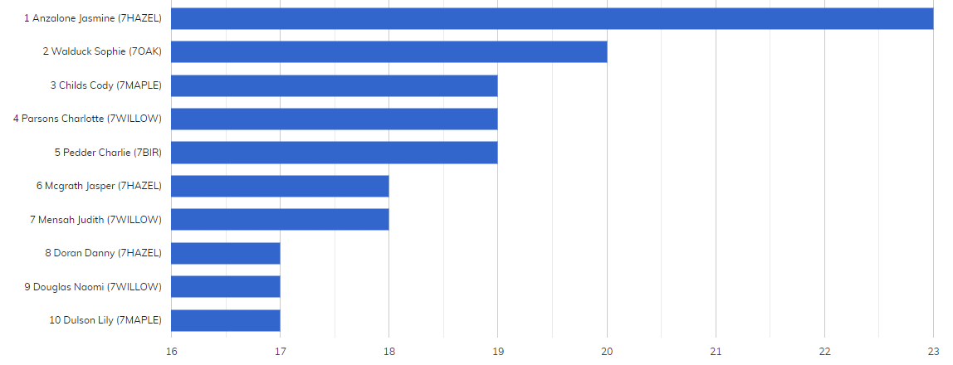
YEAR SEVEN BRONZE AWARDS

Slide 2
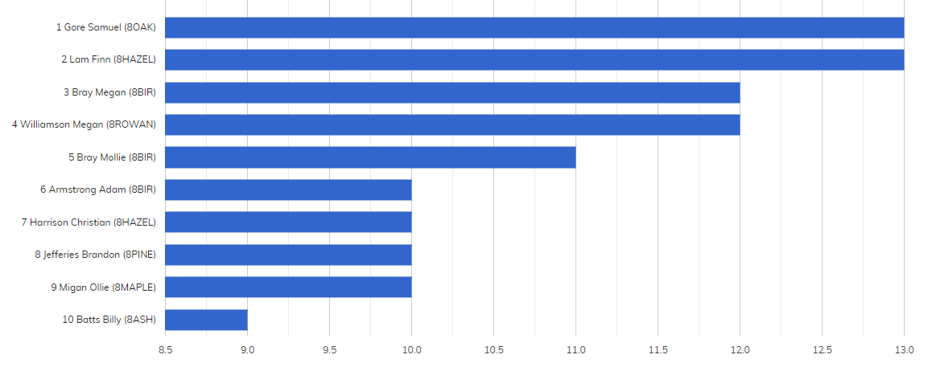
YEAR EIGHT BRONZE AWARDS

Slide 3
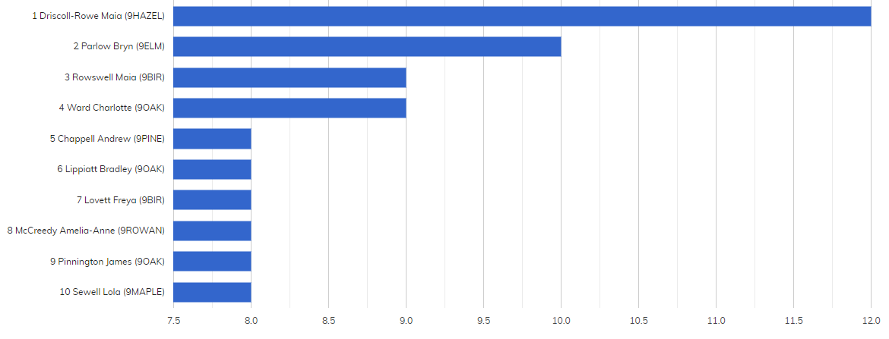
YEAR NINE BRONZE AWARDS

Slide 4
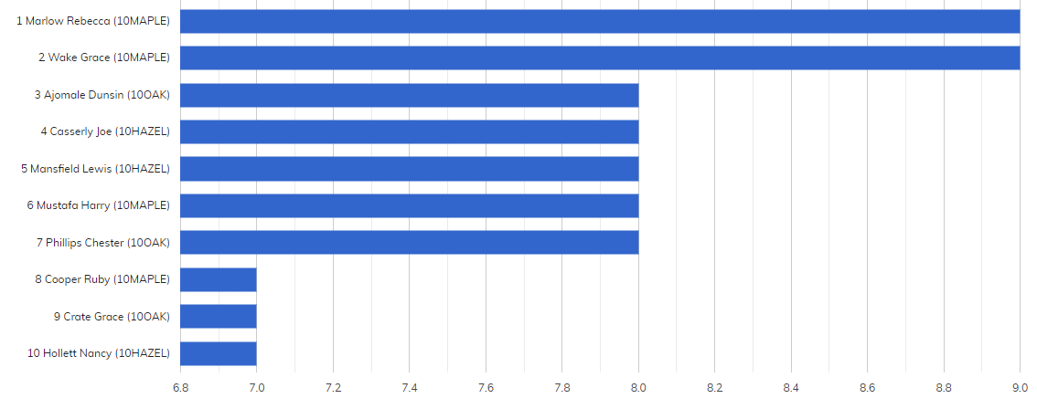
YEAR TEN BRONZE AWARDS
No awards this week – Year Ten Exams

Slide 5
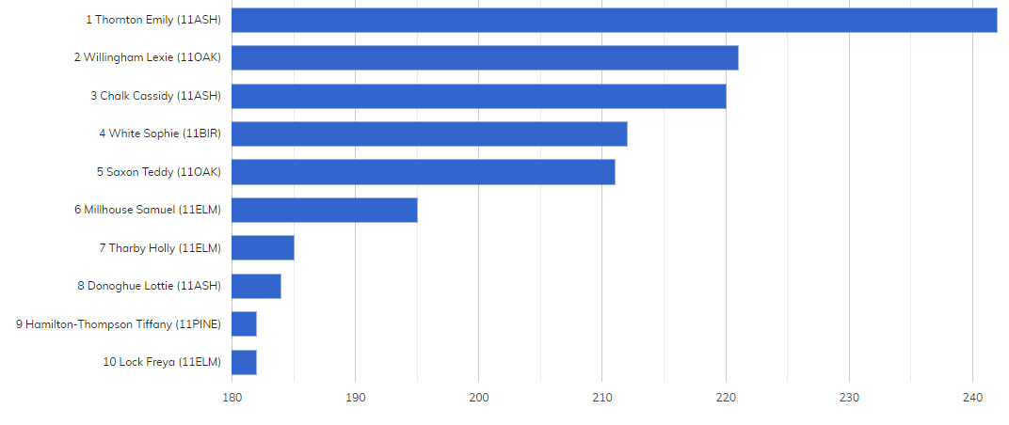
YEAR ELEVEN BRONZE AWARDS
This academic year

Slide 6
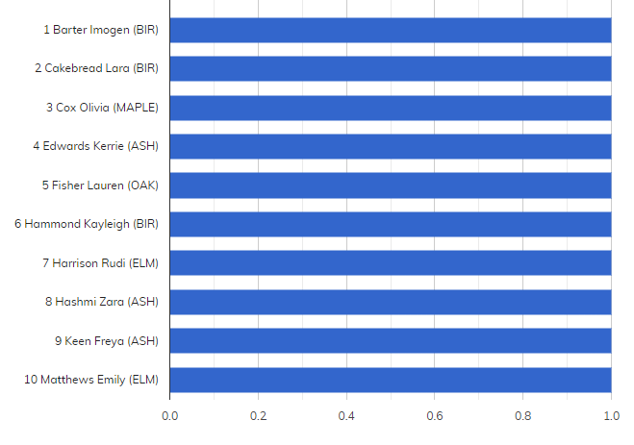
YEAR TWELVE BRONZE AWARDS

Slide 7
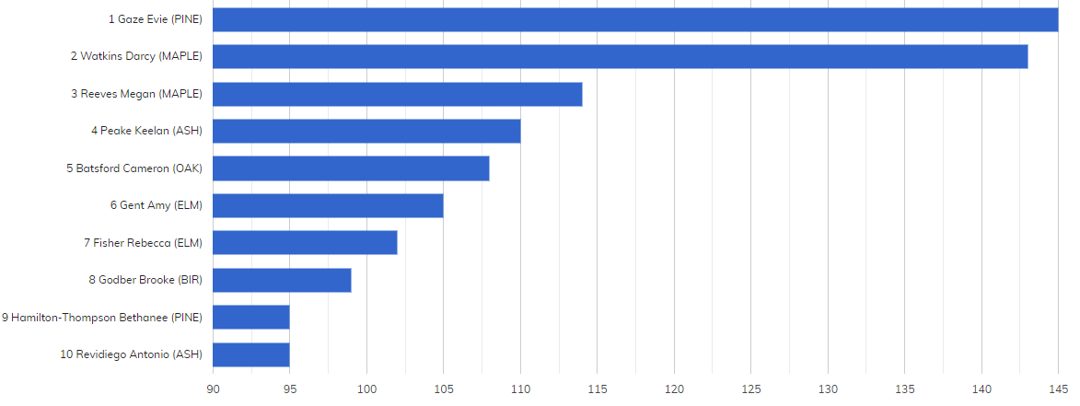
YEAR THIRTEEN BRONZE AWARDS
This academic year

Slide 8
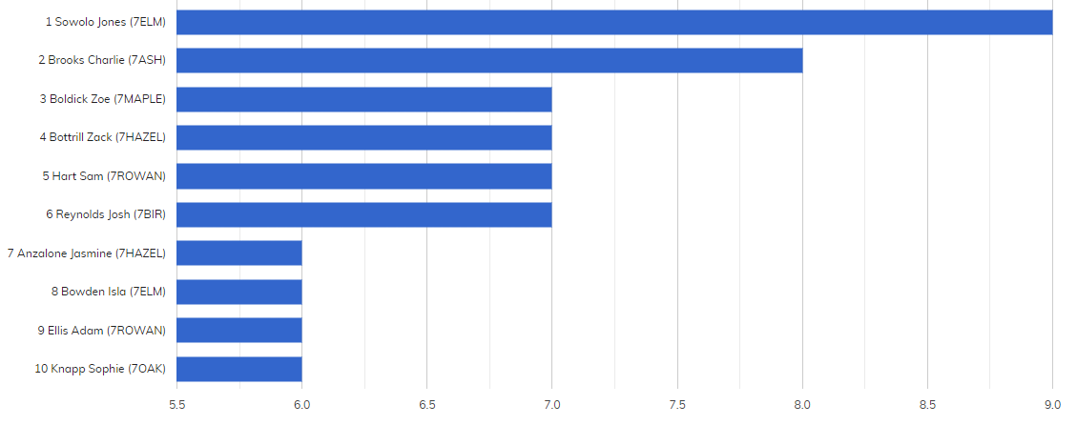
YEAR SEVEN SILVER AWARDS

Slide 9
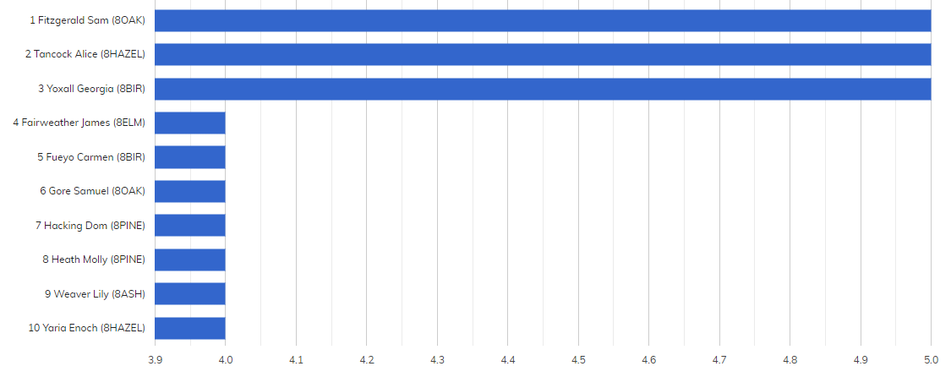
YEAR EIGHT SILVER AWARDS

Slide 10
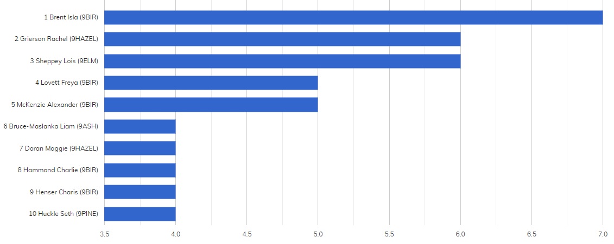
YEAR NINE SILVER AWARDS

Slide 11
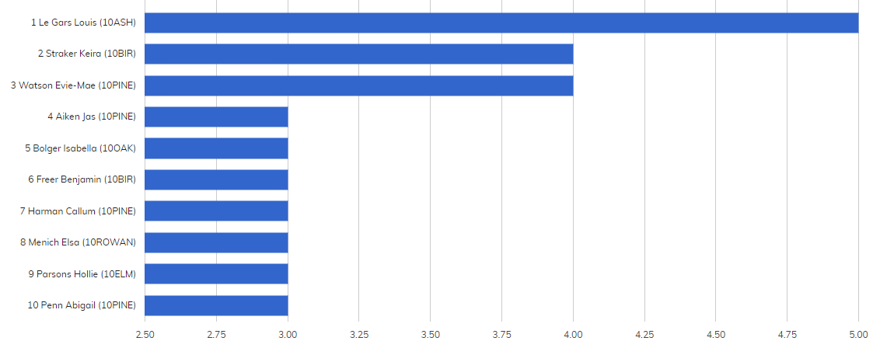
YEAR TEN SILVER AWARDS

Slide 12
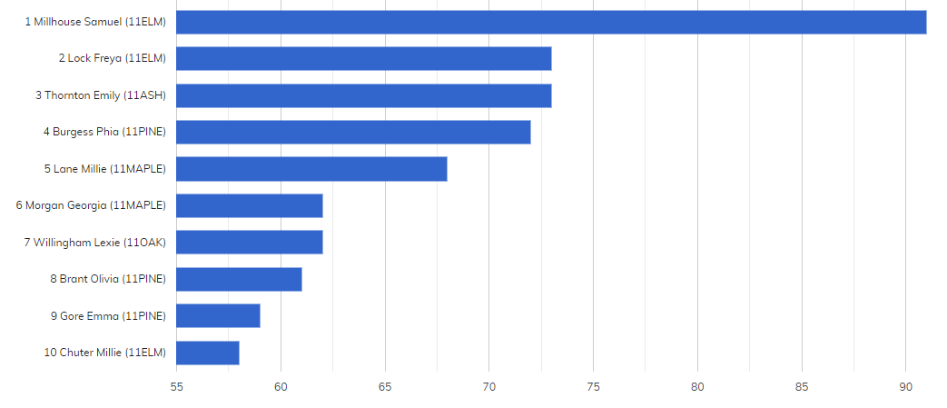
YEAR ELEVEN SILVER AWARDS
This academic year

Slide 13
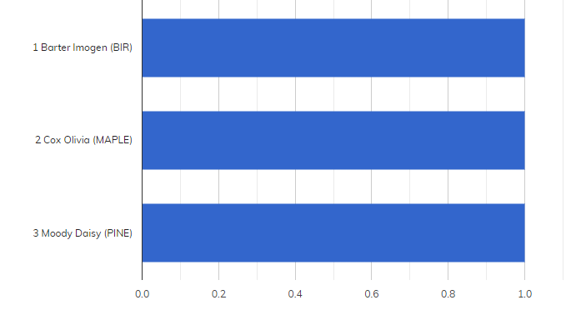
YEAR TWELVE SILVER AWARDS
None this week

Slide 14
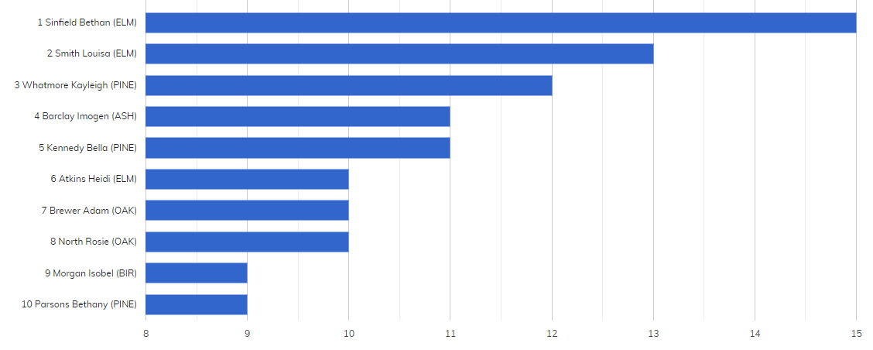
YEAR THIRTEEN SILVER AWARDS
This academic year

Slide 15
GOLD AWARDS
Ward Alex (7MAPLE) Aran Liyah (7PINE) Benadda Sami (7CHESTNUT) Bowden Isla (7ELM)
Bryant Marla (7ELM) Childs Cody (7MAPLE) Holtby Freddie (7WILLOW) Bowman-Cater Lauren (7ROWAN) King Eva (7ELM) Little Alice (7CHESTNUT) Marquez Glenice (7PINE) Medina Silva Joshua (7ROWAN)
Patmore Scarlett (7MAPLE) Pereira Harriet (7BIR) Reynolds Josh (7BIR) Walduck Sophie (7OAK)
Allsop Alfie (7ROWAN) Ambler James (8ASH) Ardiles Sofia (8MAPLE) Ashley Shakira (7ASH)
Batty Thirza (7OAK) Booth Poppy (7MAPLE) Cakebread Henry (7MAPLE) Casserly Amie (7ASH)
Cook Sophie (7HAZEL) Davis Archie (7ASH) Driscoll-Rowe Maia (9HAZEL) Flanagan Felix (7MAPLE)
Fox Joseph (7WILLOW) Gallagher Ollie (7ROWAN) Harrington Jack (7ROWAN) Hashmi Zac (7ASH)
Hawkes Amy (7CHESTNUT) Henshaw April (9BIR) Keen Eva (9ASH) Landeira Ariana (8ASH)
Levene Ruby (7ROWAN) Lewis Bobby (7OAK) Lewis Isaac (7ELM) Lombard Tristan (7OAK)
Maisey Dylan (7ROWAN) Neal William (9PINE) Neely Esme (7WILLOW) Peacock Izaac (7WILLOW)
Preston Sarah (9ELM) Rogers-Crane Charley (9OAK) Shinkins Darcey (9ROWAN) Sowolo Jones (7ELM)
Stock Zachary (7ASH) Sukroo Immy (7BIR) Swainston Isla (9ELM) Swanson Jasmine (7PINE)
Vandewalle Imogen (7OAK) Ward Michael (7OAK) Webster Jayden (7ASH) Abello Tiarni (8MAPLE)
Adekoya Davina (10PINE) Adekoya Jason (9MAPLE) Adeniyi Joel (8MAPLE) Ambridge Alfie (9OAK)
Anoyrkatis Ethan (7OAK) Ansell Rasharn (7ROWAN) Anzalone Jasmine (7HAZEL) Baker Millie (9BIR)
Balagopi Rethisha (7ROWAN) Ballard Lennie (8ROWAN) Barnaby Isla (7BIR) Barrett James (9ROWAN)
Batts Billy (8ASH) Benli Reis (7CHESTNUT) Berry Joanne (7WILLOW) Boldick Hayden (9HAZEL)
Bolger Amelia (7MAPLE) Brown Ella (7WILLOW) Buse Jack (8ELM) Bush Alfie (7BIR)
Camp Lily (8HAZEL) Cartwright Hayden (8PINE) Cason Charlotte (7BIR) Chuter Jake (9ASH)
Clark Ben (7CHESTNUT) Cockman Thomas (7WILLOW) Coffin Harry (7BIR) Coles Izzy (7PINE)
Cook Logan (7HAZEL) Corbett Ashleigh (9PINE) Crolla Evie (7OAK) Croucher Poppy (9HAZEL)
Cummines Brandon (9ASH) Cyl Billy (9PINE) Dagger Oli (7CHESTNUT) Dalli Frankie (7CHESTNUT)

Slide 16
GOLD AWARDS
Davies Tommy (8OAK) Dean-Byles Berrie (9ELM) Dell Reuben (7BIR) Dickson Ollie (9PINE)
Doran Danny (7HAZEL) Downs Alex (9OAK) Dowton Ryan (7ASH) Draycott Hector (9MAPLE)
Dulson Lily (7MAPLE) Ellis Adam (7ROWAN) Ewing Darcie (7WILLOW) Farrell Mabel (7BIR)
Field Jack (9MAPLE) Ford Josh (7HAZEL) Foulger Tony (7CHESTNUT) Foxon Archie (10HAZEL)
Freer Benjamin (10BIR) Freer George (9MAPLE) Gascoigne Rivve (9ELM) Gibbins Olivia (9BIR)
Gibbs Mitchell (7HAZEL) Gilewicz Zach (7OAK) Glenister Will (7ASH) Gough Sunny (7ELM)
Gray Alfie (7MAPLE) Green Lyla (7MAPLE) Hagger Harrison (7ROWAN) Hall Izzy (7ASH)
Hamlin Tegan (7ROWAN) Hammond Charlie (9BIR) Harbert Laila (10OAK) Harold Max (7ASH)
Harter Stanley (8BIR) Harwood Joe (8MAPLE) Henser Charis (9BIR) Hill Leyla (8PINE)
Hobbs Charlie (7CHESTNUT) Hughes Calli (9ROWAN) Hughes Ella (9PINE) Jefferies Brandon (8PINE)
Johnson Steven (7ASH) Jones George (7CHESTNUT) Joshi Jimit (7ELM) Kadlec Summer (9ASH)
Kennedy Anna (9ELM) Khurody Jake (7MAPLE) Kilighan Aden (7WILLOW) Kimpton Holly (7WILLOW)
King Mason (7WILLOW) Knight Finley (9ROWAN) Laudato Ilaria (8BIR) Laverick Ellie (10MAPLE)
Levene Leila (7HAZEL) Lewis Thomas (9BIR) Liddiard Amy (8ELM) Lippiatt Bradley (9OAK)
Luck-Chalk Theo (7ELM) Malcolm-Stewart Elise (10MAPLE) Mangeolles Max (7WILLOW) Mansfield Charlie (8HAZEL)
March Harry (7HAZEL) Marsh Molly (7OAK) Martin Tommy (9HAZEL) Matthews Thomas (7HAZEL)
Meikle Kaya (7BIR) Miller-Bruton Jack (7PINE) Milroy Oscar (9MAPLE) Morgan Noah (8ASH)
Neal Adam (7PINE) Nicholls Kaiden (7ELM) Niebank Molly (7HAZEL) Nimmo Daniel (10ROWAN)
Nippard Daisy (8HAZEL) O'Brien Kitty (7MAPLE) O'Reilly Amy (9ASH) Onwordi Ekene (8PINE)

Slide 17
GOLD AWARDS
Owen Henry (7BIR) Pai Ayush (7ELM) Parker Chloe (8PINE) Parlow Bryn (9ELM)
Parrish Matilda (7CHESTNUT) Pateman Billy (9ROWAN) Petts Archie (7HAZEL) Philippou-Kiamil Crystal (8HAZEL)
Phillips Ronnie (9BIR) Phillips Ruby (10ROWAN) Pullen Bobby (7CHESTNUT) Rathor Simarjit (10ELM)
Reed Harry (7CHESTNUT) Ridley Devon (7OAK) Saban Amy (7OAK) Sampford Rylie (7HAZEL)
Samson Alfie (8PINE) Samuel Harry (7PINE) Samuels Russell (8HAZEL) Sarfo-Adu Anna (10PINE)
Schertel Liam (7ROWAN) Selby Thomas (7CHESTNUT) Sharp Alfie (7OAK) Shuffield Bella (8MAPLE)
Simpson Oliver (7OAK) Skidmore Benjamin (8OAK) Southcombe Zachary (10OAK) St John-Clarke Olly (7ELM)
Stagg Carter (7WILLOW) Stewart-Smith Lola (7PINE) Stock Serenity (10BIR) Straker Keira (10BIR)
Stretch Grace (7BIR) Swindale Sasha (9MAPLE) Tacea Andrei (9ASH) Taggart Freya (7PINE)
Tharby Calum (9HAZEL) Tharby Danni (9ASH) Thorpe Tilly (7HAZEL) Tierney Bow (7ROWAN)
Tucker Belle (7WILLOW) Tumber Sienna (7ELM) Varelis Alex (9MAPLE) Vimeux Titouan (7MAPLE)
Wallace Jones Harrison (7BIR) Walls Isabelle (8ASH) Walsh Emma (8ASH) Wanless Charley (7ELM)
Ward Will (7PINE) Wells Alfie (9OAK) Whichelow Chloe (9PINE) White Aaron (8BIR)
Whyatt Megan (9ELM) Williams Lilly (7ELM) Witherow Liam (10MAPLE) Worster Louie (7BIR)
Yadav Atharva (7PINE) Yaria Enoch (8HAZEL) Yoxall Georgia (8BIR)

Slide 18
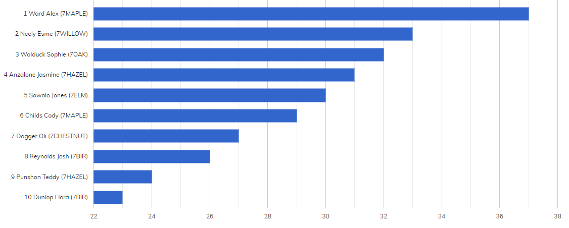
TOP TEN CHAUNCY AWARDS (NO OF SLIPS) YEAR SEVEN

Slide 19
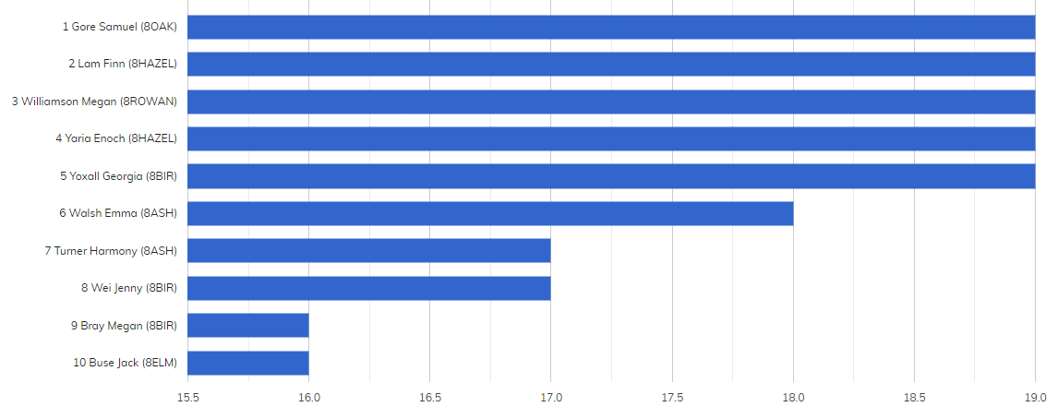
TOP TEN CHAUNCY AWARDS (NO OF SLIPS) YEAR EIGHT

Slide 20
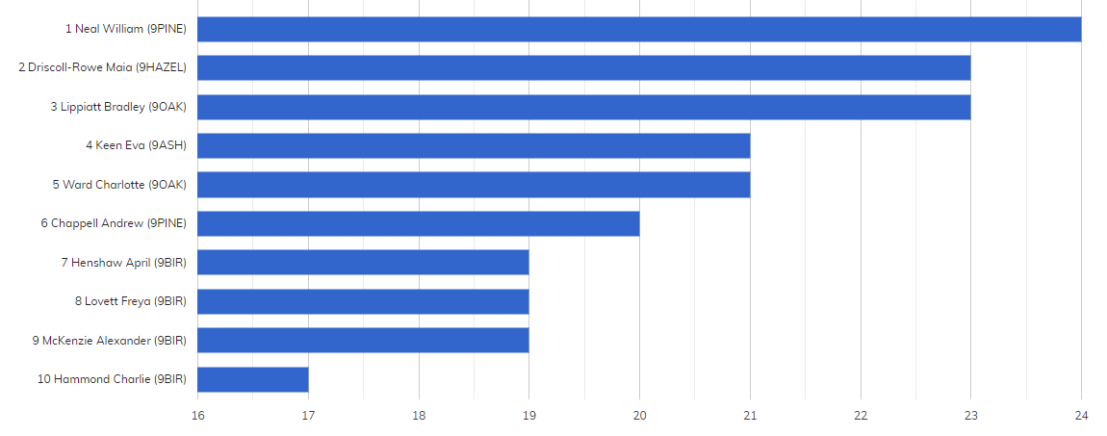
TOP TEN CHAUNCY AWARDS (NO OF SLIPS) YEAR NINE

Slide 21
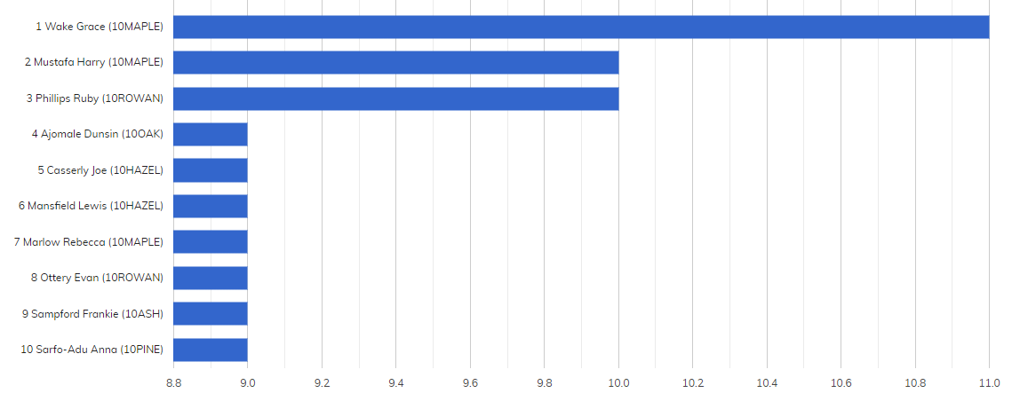
TOP TEN CHAUNCY AWARDS (NO OF SLIPS) YEAR TEN

Slide 22
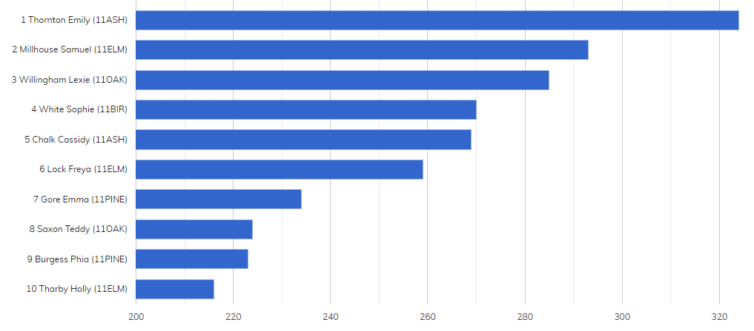
TOP TEN CHAUNCY AWARDS (NO OF SLIPS) YEAR ELEVEN
This academic year

Slide 23
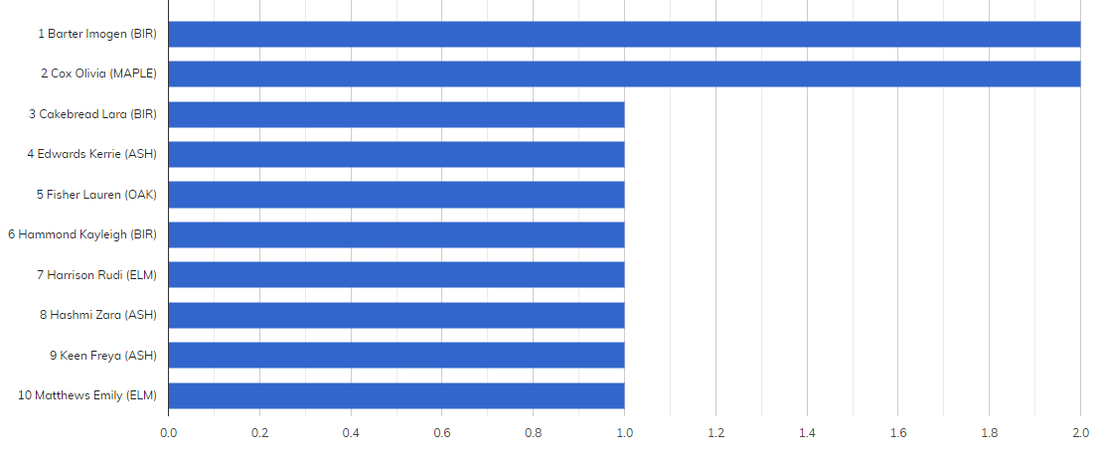
TOP TEN CHAUNCY AWARDS (NO OF SLIPS) YEAR TWELVE

Slide 24
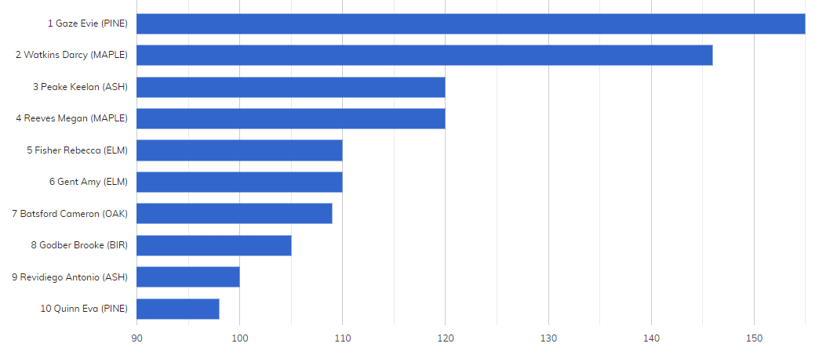
TOP TEN CHAUNCY AWARDS (NO OF SLIPS) THIRTEEN
None this week
This academic year

Slide 25
ACHIEVEMENTS
Ansell Rasharn (7ROWAN) Butler Keira (7CHESTNUT) Casey Tia (7ASH) Culling Liam (7MAPLE)
Dagger Oli (7CHESTNUT) Draper Maisie (7ROWAN) Fairweather James (8ELM) Freeman Chloe (7ASH)
Gallagher Ollie (7ROWAN) Hamilton Josh (7ROWAN) Hamlin Tegan (7ROWAN) Hawkes Amy (7CHESTNUT)
Holtby Freddie (7WILLOW) Kelly Reid (9OAK) King Eva (7ELM) Lamb Eleanor (7HAZEL)
Leenders Bella (7ASH) Neely Esme (7WILLOW) Niebank Daisy (7ROWAN) Pereira Harriet (7BIR)
Punshon Teddy (7HAZEL) Ridley Devon (7OAK) Sandu Ava (7ASH) Shirley Freddie (7HAZEL)
Stephens Jake (7MAPLE) Walduck Sophie (7OAK) Ward Bethany (7MAPLE) Wrangles Grace (7ELM)
York George (7MAPLE)

