Slide 1
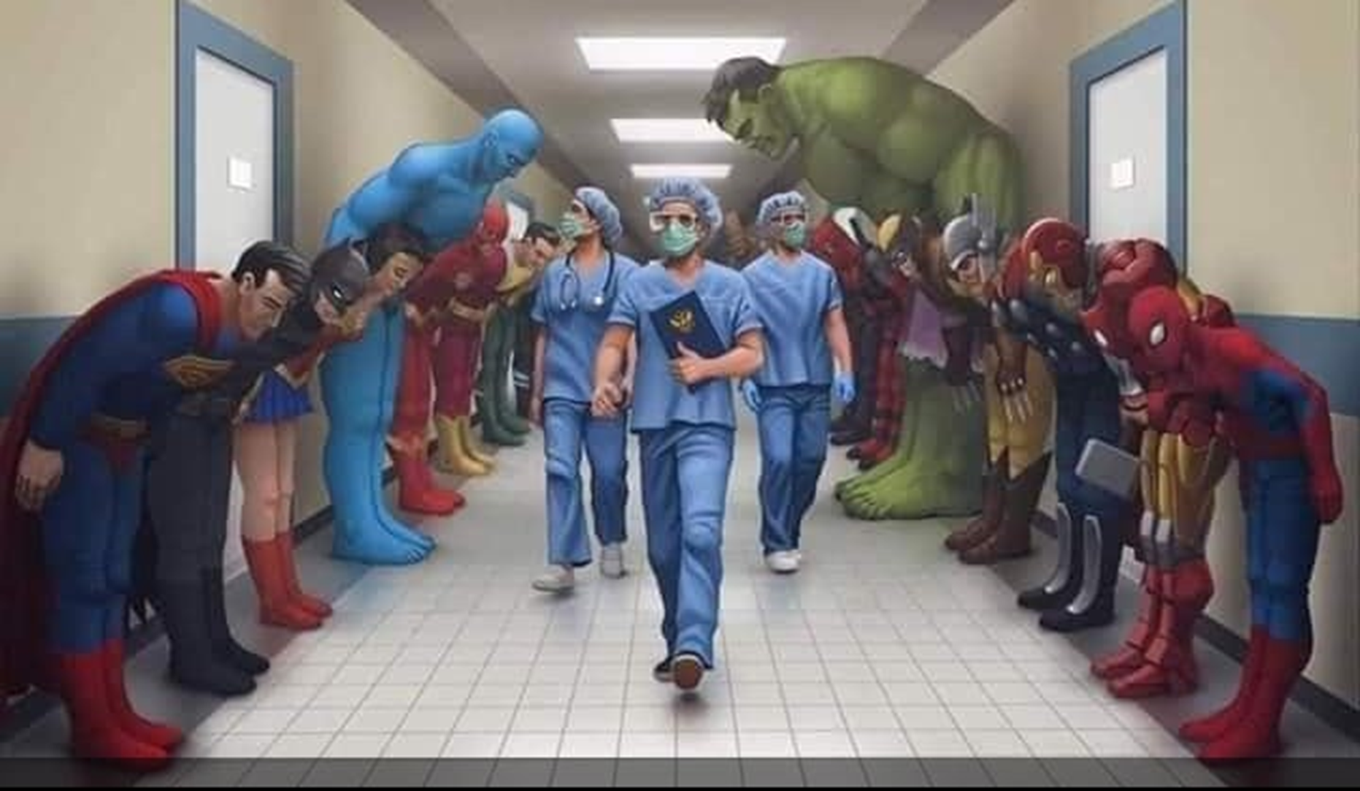
Health and Social Care GCSE BTEC
If you are interested in learning more about the organisations that are currently supporting our nation, then why not consider Health and Social care.

Slide 2
Press play to watch the video

Slide 3
Why study Health and Social care?

Slide 4
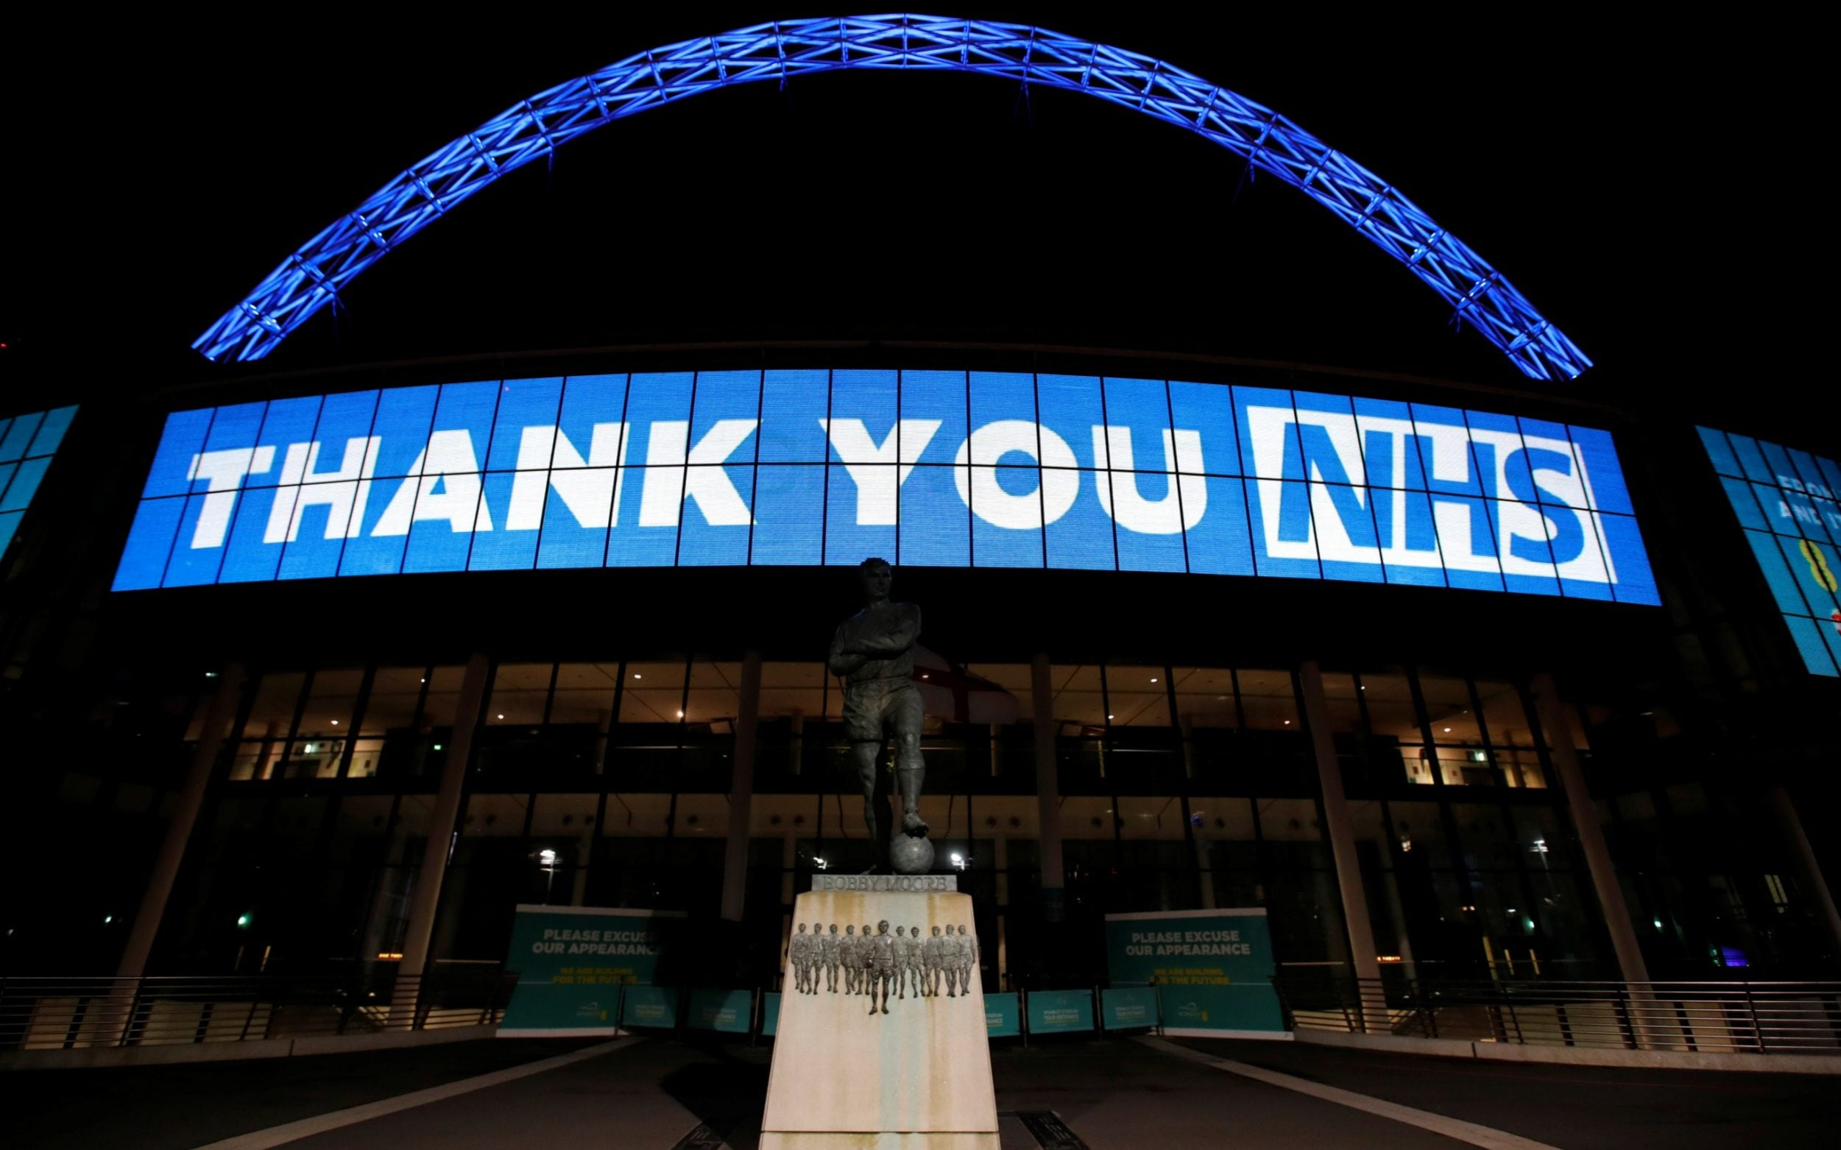
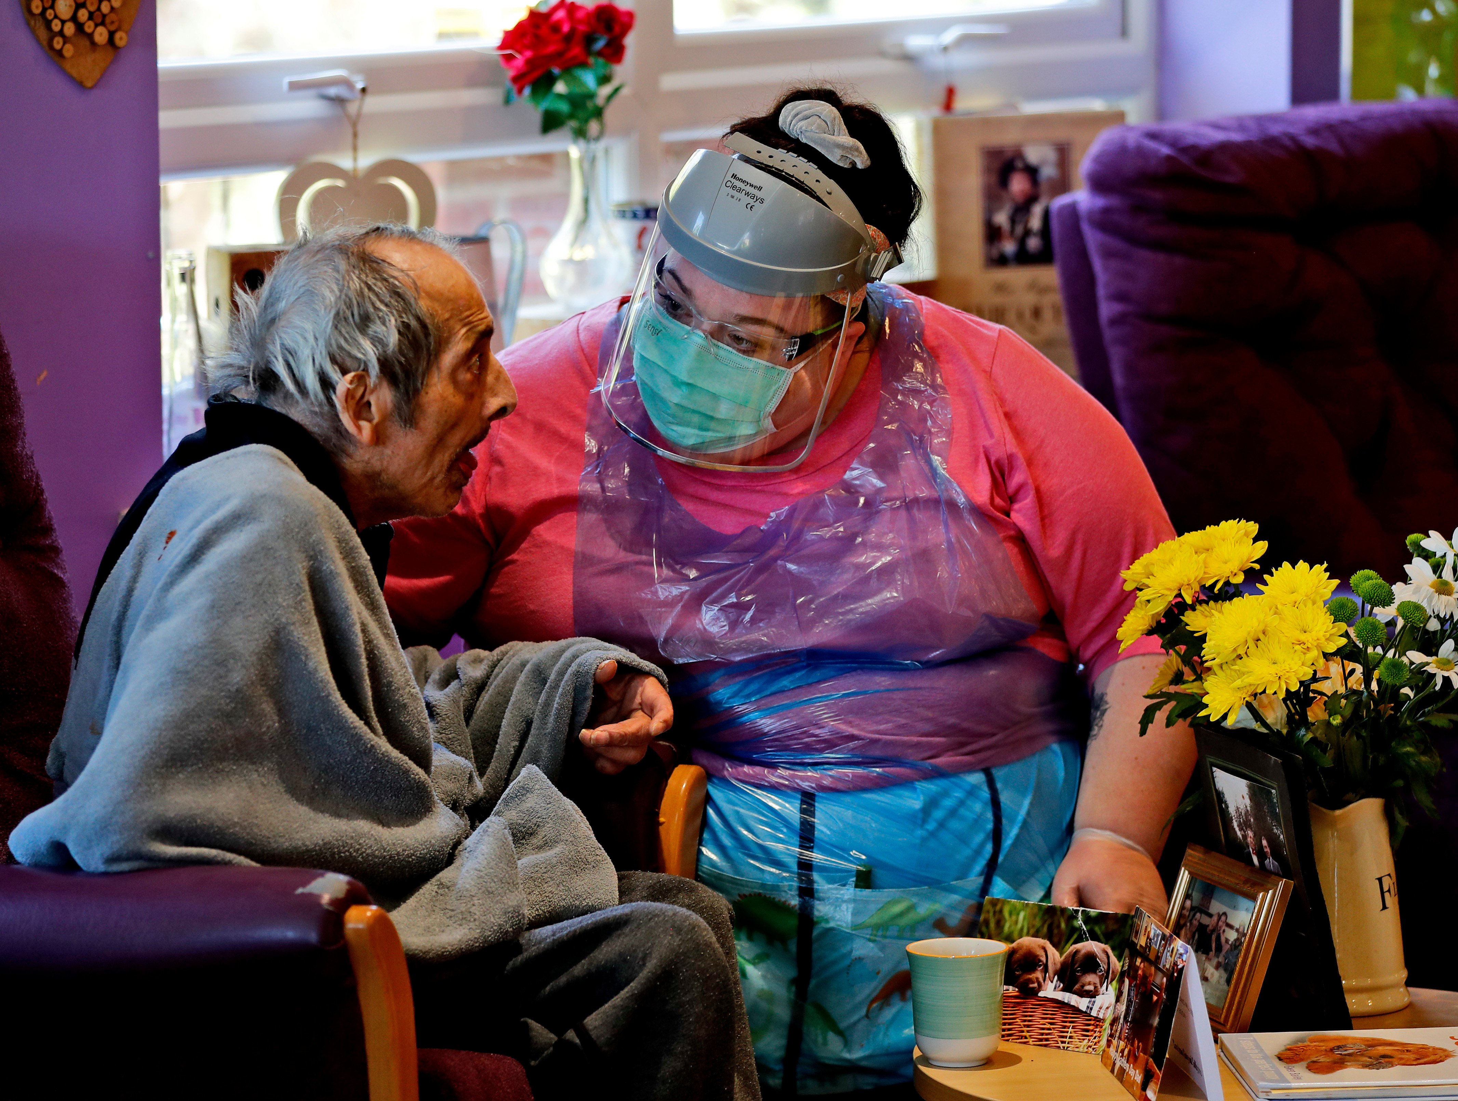
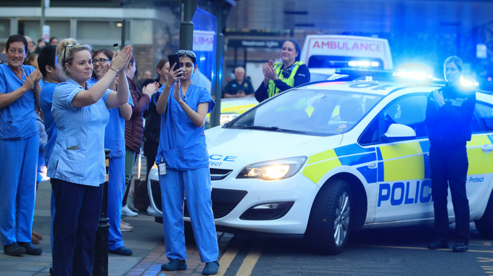
We wouldn’t have our key workers without it. It’s all about wanting to make a positive difference to people’s lives.

Slide 5
What jobs can you go into after studying Health and Social care?

Slide 6
There are over 1000 different careers in health and social care, the NHS is one of the biggest employers in the world, so there are careers to suit all. Here are just a handful.
Health care careers
DENTISTRY & DENTAL HYGIENE
DIAGNOSTIC RADIOGRAPHY - Using x-rays and scanners to see through a medical problem
FORENSICS & PATHOLOGY
LIFE SCIENCES - Living it up in the lab
MEDICAL DOCTORS & SURGEONS - Saving lives on a daily basis
MEDICAL RESEARCH & DEVELOPMENT - The forefront of new drugs and treatments
NURSING & MIDWIFERY
NUTRITION & DIET
PARAMEDIC & AMBULANCE SERVICES
PHARMACY & PHARMACEUTICALS
SEXUAL HEALTH
MEDICAL SALES & MARKETING
PHYSIOTHERAPY, REHABILITATION & OCCUPATIONAL
PSYCHOLOGICAL THERAPY - HEALTHCARE: SPEECH & LANGUAGE THERAPY

Slide 7
Social care careers
ADULT SOCIAL CARE
ADOPTION & FOSTERING
ALCOHOL & SUBSTANCE Misuse
CHILDREN & FAMILIES
DOMESTIC VIOLENCE
HOUSING & HOMELESSNESS
LEARNING Disabilities
MENTAL HEALTH
PHYSICAL & SENSORY Impairment
YOUTH WORK & YOUTH JUSTICE
Along with the many Health and Social care jobs listed, it is also useful for careers in teaching and child care

Slide 8
Many students use the course as a stepping stone to then completing the A level in Health and Social care in sixth form.

Slide 9
How will you be assessed?

Slide 10
You will be assessed through 2 pieces of coursework and 1 exam
You will complete the coursework during class time, so working at a computer independently is important.
You will sit your exam at the end of year 10
On average students achieve 1.5 grades above their target grade in this subject.

Slide 11
What does the GCSE course involve?

Slide 12
Unit 1: Human Lifespan Development
Assessed – Coursework
Learning aims
A) Understand human growth and development across life stages and the factors that affect it.
B) Investigate how individuals deal with life events.
Here you get the opportunity to choose three people, who have gone through big life events and analyse how this has impacted them.
Unit 2: Health and Social Care Services and Values
Assessed – Coursework
Learning aims
Understand the different types of health and social care services available and barriers to accessing them.
B) Demonstrate care values and review own practice.
Here you will take on the role of a social worker for two case studies. You will review their needs and decide the correct services to help with these.
Unit 3: Health and Wellbeing
Assessed – Exam
Here you look at the factors that can have a positive or negative influence on a person’s health and wellbeing. You will learn to interpret physiological and lifestyle indicators, and what they mean for someone’s state of health. You will learn how to use this information to design an appropriate plan for improving someone’s health and wellbeing, including short- and long-term targets.

Slide 13
If you would like to find out more, about where Health and social care can lead and why people choose it, please watch the following clips. Also if you have any questions regarding the course, please email me at jo.carlyle@chauncy.org.uk
https://www.youtube.com/watch?v=6ggb_-kLppc&fbclid=IwAR2tHk89vbAifmi-7lqecbr_HqPpkb_FkzD6SRenT6_OOSggN4FitcrVLRw
https://www.bbc.co.uk/iplayer/episode/m000hqvk/rhod-gilberts-work-experience-series-9-1-care-worker

