Slide 1
How to Revise

Slide 2

Help! I don’t know how to revise!

Slide 3
What is the point of revision?
It is to remember things.
The best way to remember is through cues.
A cue is something that you associate with something else.

Slide 4

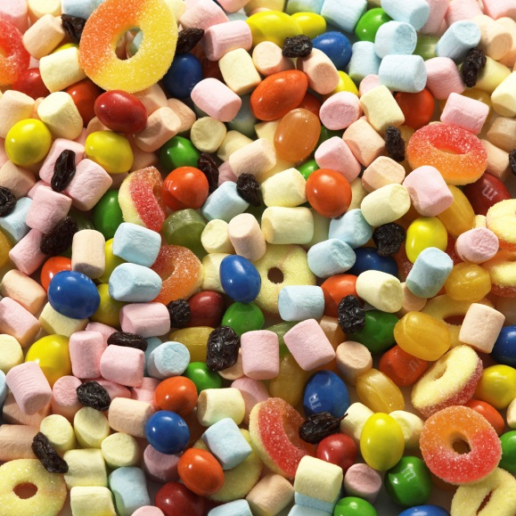


Colour, Smell, Taste, Sound
All things that you have at your fingertips.

Slide 5
The first rule of revision:
Don’t worry.
Worrying will put you off and stop you from doing anything at all.

Slide 6
Second rule of revision
Do not take the easy option and go over things that you already know.
This might make you
feel better
(and boost your
confidence) but
actually is of no
benefit.

Slide 7

Third rule of revision
Find out exactly what you need to know!
Look at the textbook or revision guide– this will often summarise what you need to know.

Slide 8

Final Rule:
Plan your revision. There’s no point in trying to cram too much in.
You know when your exam is. What will you need to cover by that date?

Slide 9
How to Revise…
 | MON | TUES | WEDS | THURS | FRI | SAT | SUN
Morning | SCHOOL | SCHOOL | SCHOOL | SCHOOL | SCHOOL | HIST - WW2 | FRENCH - writing
Afternoon | SCHOOL | SCHOOL | SCHOOL | SCHOOL | SCHOOL | RELAX | RECAP - WW2
Evening | MATHS - algebra | ENG – poems | BIOL - nerves | RECAP – algebra - poems | CHEM – salt | RECAP - nerves - salt | RELAX
Spend time making a thorough revision timetable and STICK TO IT

Slide 10
How can I revise then?
Everyone is different and so you all have different things that work for you.
It isn’t a good idea to write out all of your notes all over again. There are so many things you can try:

Slide 11
Revision Cards
Write a keyword on a card using your textbook for cues.
Read the relevant part of the textbook.
Come back to your cards and try to write notes on them (this tests your memory)
You can then flick through the cards to help you remember.

Slide 12
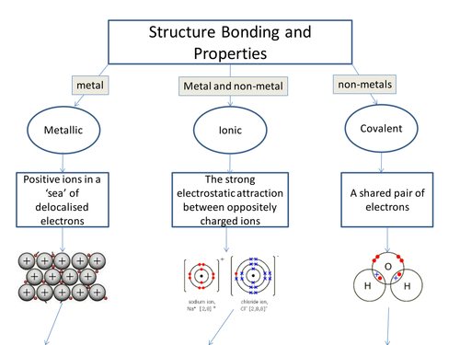
Flow Charts
This breaks down the information you need into small chunks.

Slide 13
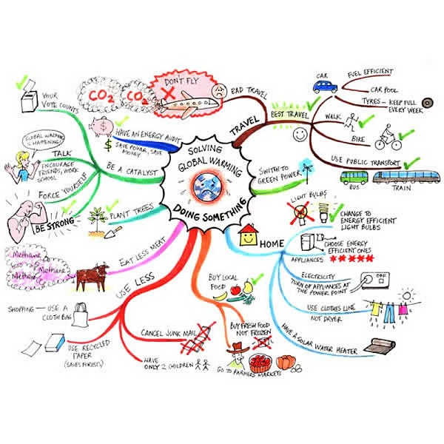
Spider Diagrams

Slide 14
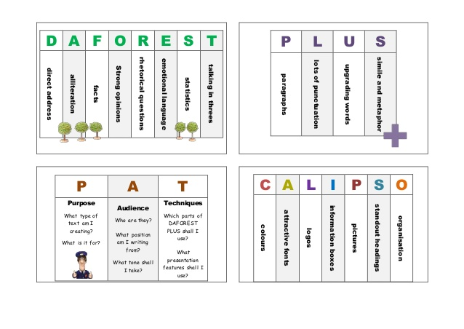
Mnemonics
Or try:
Rhymes
Songs

Slide 15
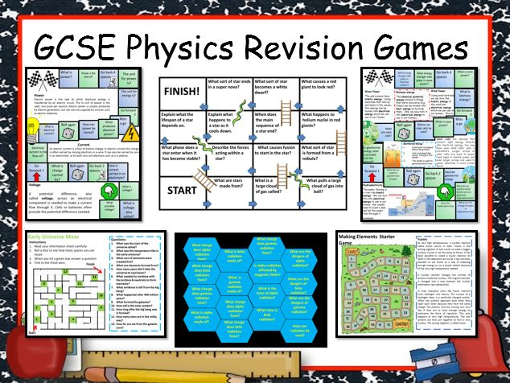
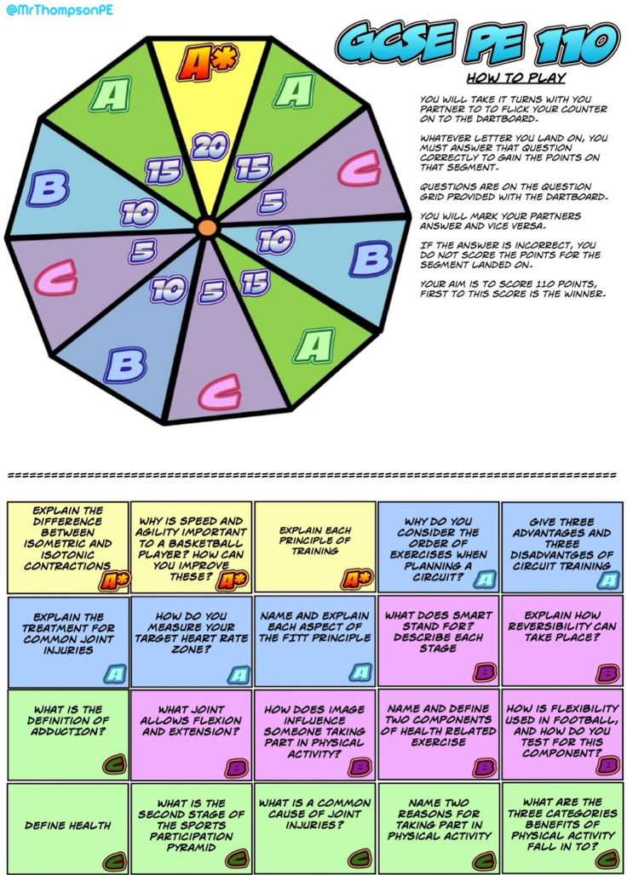
Games
Snap
Pairs
Internet games

Slide 16

Lists
Write lists –
Use colour
Different pens / paper

Slide 17
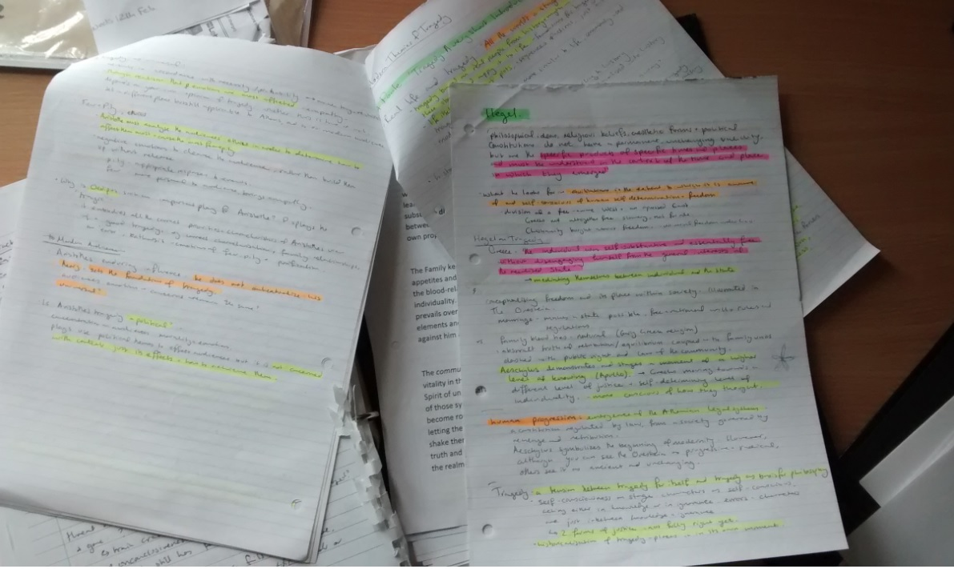
Highlight Notes
Go through your existing notes with a highlighter. This way your attention is drawn to important bits.

Slide 18
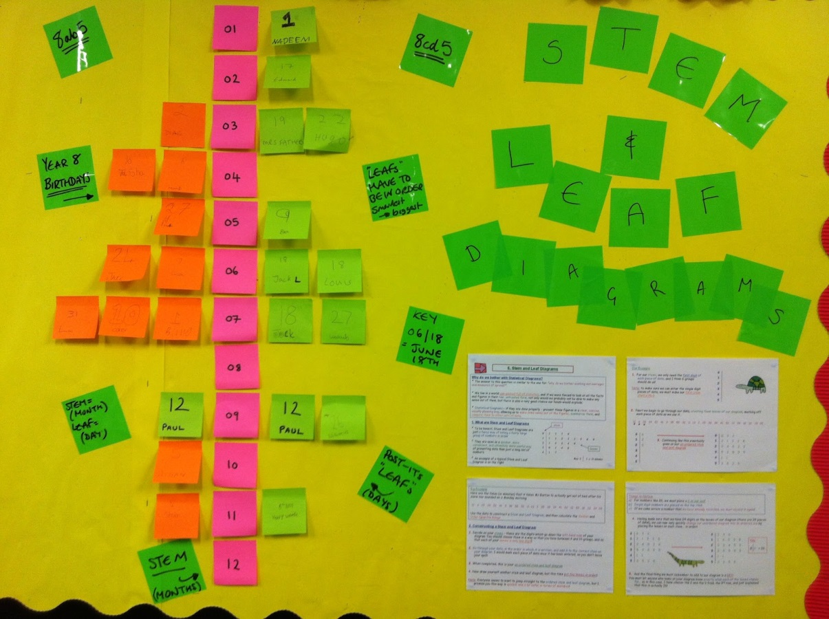
Use post it notes
All around your house – put keywords in the toilet, on your bedroom wall, on your tv etc

Slide 19

Read out loud
Record the information onto your iThingy or your phone.
Play it back when you are going to sleep.

Slide 20
The Internet
There are masses of resources available online:
- BBC Bitesize
Revise science:
www.revisescience.co.uk

Slide 21

Talk to your friends
Talking about it can help.
Have a pizza, turn on some music and have a revision party.

Slide 22
It is not all about facts
Learning facts is only part of the battle.
You need to arrange your thoughts on paper and make sure you answer the question.

Slide 23
Use the school resources
SAM learning
Doddle
Mymaths
Kerboodle
Moodle
Quizlet

