Slide 2
GCSE Results 2016
Progress 8
0.5
Students taking 10 GCSEs at Chauncy achieve, on average, 5 grades more than other students nationally

Slide 3
GCSE Results 2016
Top 7% nationally

Slide 4
Progress 8 – Local Schools
P8
Broxbourne 0.33
John Warner -0.08
Presdales 0.32
Richard Hale 0.07
Sele -0.02
Sheredes -0.01
Simon Balle 0.62
Chauncy 0.47 (0.5 with 2nd entries)

Slide 5
Compared with 55 ‘Similar’ Schools
Position
Broxbourne 16th
John Warner 27th
Presdales 17th
Richard Hale 40th
Sele 14th
Sheredes 29th
Simon Balle 2nd
Chauncy 2nd

Slide 6
16 – 19 Value Added – Local Schools
A Level Applied General
Herts Regional College SUPP -0.33
John Warner -0.34 -0.45
Presdales -0.09 NE
Richard Hale -0.11 -0.11
Sele -0.6 -0.21
Simon Balle +0.1 +0.23
Chauncy +0.02 +0.12

Slide 8
Smart revision?
A bit of theory
A few tips

Slide 9
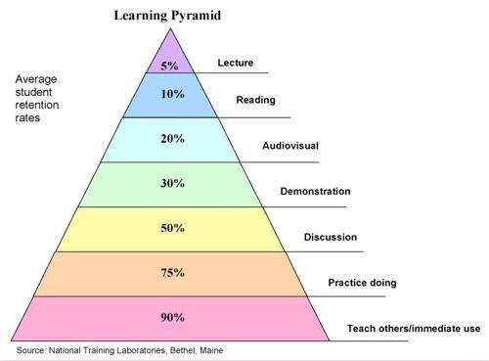
How do we learn best?
Listening to someone, reading, watching videos – not so good
How much we remember from these learning styles
GOOD – explaining to others, practising, doing

Slide 10
Revision techniques to be avoided
Copying out your notes
Highlighting/Underlining (can hinder revision!!)
Re-reading

Slide 11
HIGH VALUE REVISION
Translating information into a new form
Self testing to check knowledge
Recognising strengths and weaknesses
Past paper practice
Discussing ideas with others

Slide 12
Revision strategy has let you down in the past?
Ask for help
Who from?
Your teachers!!
(4 days until Easter!)
Or you could try the same thing ONE MORE TIME. Maybe this time it will work!

Slide 13
What makes effective revision?

Slide 14
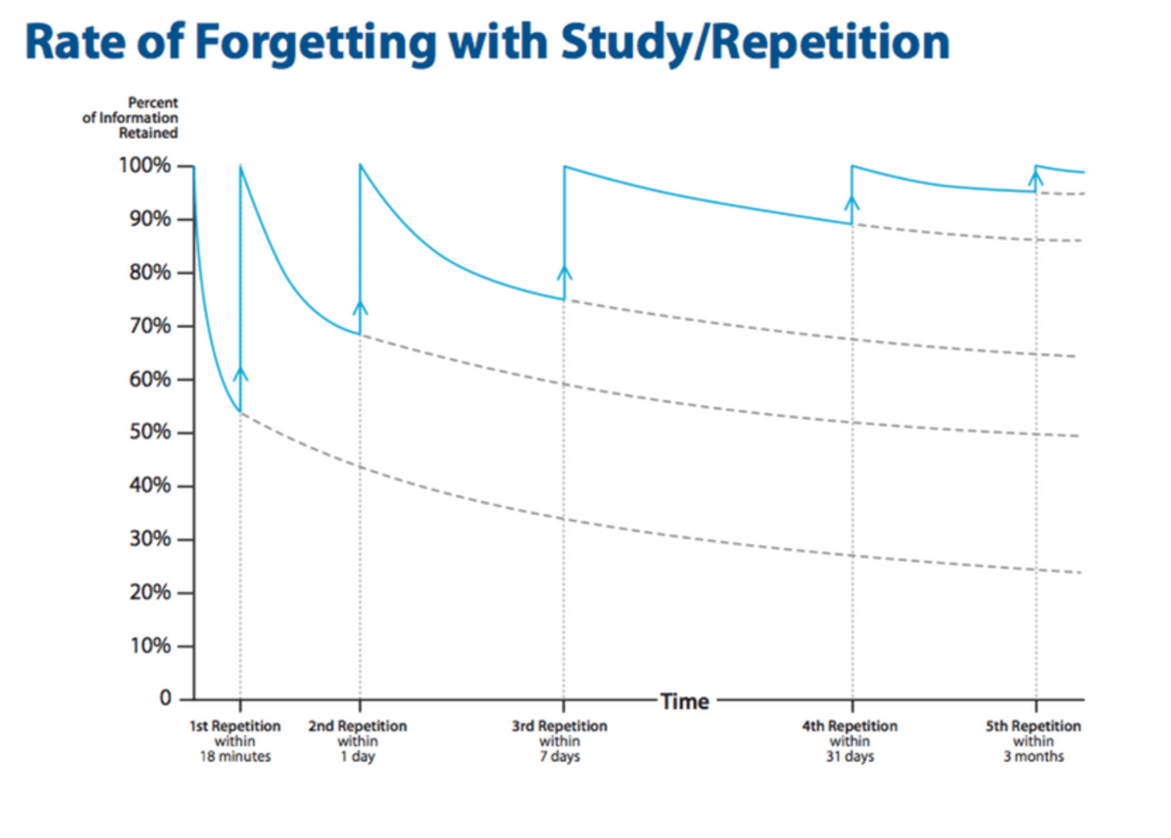
Spacing and repeating
1 day
6 days
24 days

Slide 15
You need a cunning master plan!

Slide 16
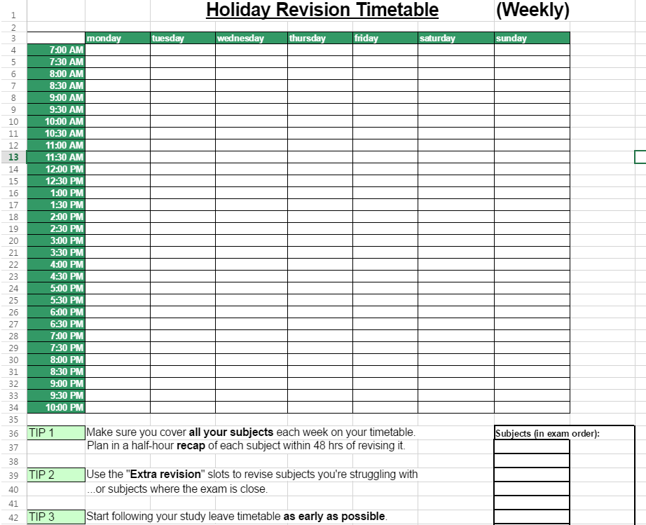

Slide 17
PLAN YOUR REVISION > including breaks and rewards or treats, family events, sporting events etc. But make sure you start early and give enough time to each subject.

Slide 18
Example spaced timetable
English
Science
RE/Ph&E
Maths
Monday
Tuesday
Wednesday
Thursday
Friday
Saturday
Sunday
Biology
Biblical examples of experiences
Topics for the 8 mark question
Jacobean theatre
Biology
The existence of God
Morning off
Theme of power and control
General Binomial Expansion
Physics
Partial Fractions
Right and wrong
Partial Fractions
BREAK
Parametric Equations
Act One character and plot
Go to Gym
Physics
Physics
Theme of Power and control
Birth and death
Act One character and plot
Biology
The existence of God
Algorithms
Parametric Equations
Spare hour
BREAK
Birth and death
Go to cinema
English Past Paper
2 hours
Right and wrong
Watch football
Friend’s
Party
Maths Past Paper
1 hour 30

Slide 19
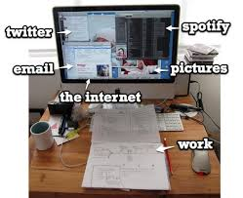
Your study environment

Slide 20
Three tips…
Mr Burnett’s top tips…

Slide 21
1.
Choose an effective method…
Use an effective revision method.

Slide 22
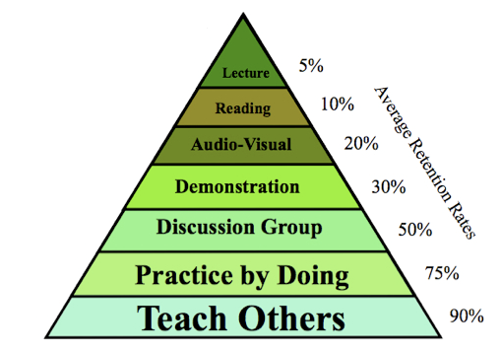

Slide 23
Common revision methods that work
Flash cards
Concept mapping
Repetition of definitions, laws, formulae
Group discussions to check understanding
Little and often (“spacing”)
Worked examples
In class testing
Self testing
Have a parent check your basic factual knowledge
Past paper practice
http://www.theconfidentteacher.com/2013/04/effective-revision-strategies/

Slide 24
2.
Put the time in…
Put the time in…

Slide 25
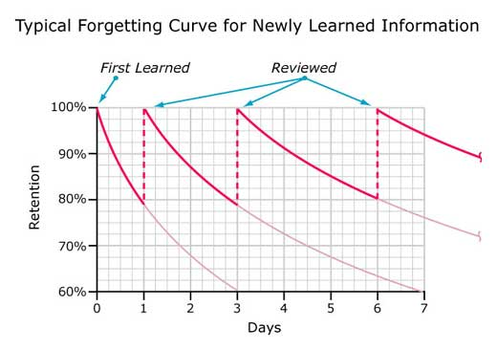

Slide 26
Use a revision plan
Build in breaks, leisure, sport and treats
Little and often is better than a long session then nothing for a week.
Build up your “revision stamina”

Slide 27
3.
Check you’ve got it…
Check you’ve got it…

Slide 28
Know it
Don’t yet

Slide 29
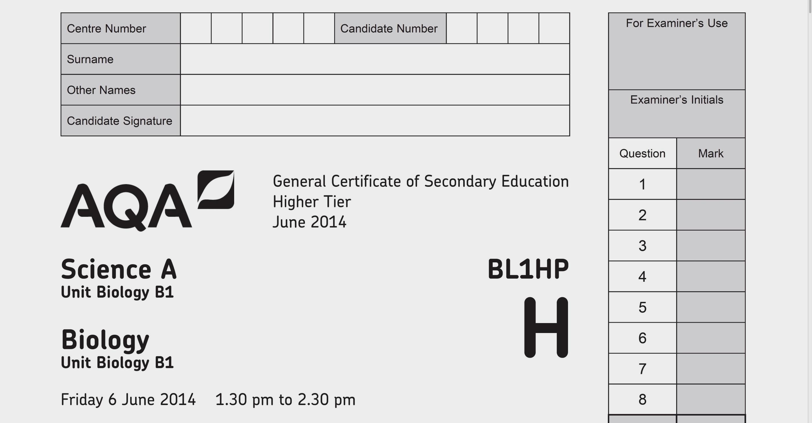
Past papers

Slide 30
17 days in the Easter holiday
Notes:
Presdales +6
RH +6
SB +5
Freman +5
JW +8
Sele -6

Slide 31
summary
Plan; developing a revision timetable
Use effective revision methods
Put the time in
Check you’ve got it

