Slide 1
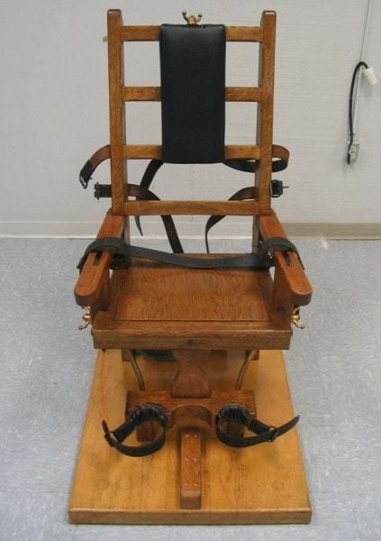
GCSE Religious Studies
Philosophy and Ethics

Slide 2
Course overview
AQA Religious Studies A
100% exam
2 exams at the end of Year 11
Paper 1 Beliefs and Practices | Paper 2 Themes
Students will study the beliefs and practices of TWO religions : Christianity Islam | Students study ethical and philosophical themes relating to the following topics: Religion and Life The Existence of God Relationships and families Crime and Punishment
https://www.aqa.org.uk/subjects/religious-studies/gcse/religious-studies-a-8062/subject-content/component-2-thematic-studies

Slide 3
How do we know that we are doing the right thing?
Should abortion be banned?
Is religion sexist?
Can we ever prove that God exists?
Should the UK reinstate the death penalty?
Some of the thousands of questions addressed on this course
Do miracles happen?
Does suffering prove there is no God?
Do animals have rights?
Are we free?
Are we free?
Are ghosts, past-life memories and near-death experiences proof of life after death?
What does religion have to say about homosexuality?
Is corporal punishment ever justified?

Slide 4
Outstanding GCSE Results
In 2019…
40% of students achieved a grade 9
80% of student achieved a grade 8 or 9 (Equivalent to an A*)
On average, student results were 2 FULL GRADES HIGHER than predictions.
Every year the Religious Studies class achieves impressive results.

Slide 5
Reasoning and analysis
Writing skills
Listening skills
Transferable skills
Evaluation
Using quotes
Empathy
Debate

Slide 6
Common Questions
Do you have to be religious to take Religious Studies?
No, not at all! You can have a strong faith or none. What matters is that you like learning about other people and expressing your own views.

Slide 7
I know this subject has a lot of discussion and debate. I’m not great at talking in front of the class, so is this subject for me?
Don’t worry! The most important thing is that you are interested in learning about other people. As long as you appreciate different sides of an argument and can present them in writing, you will be absolutely fine! We will never force you to do things that make you uncomfortable, but you might find that you take a more active role in discussion once your confidence grows. I usually find this to be the case!

Slide 8
What career does GCSE Religious Studies prepare me for?
GCSE Religious studies is all about people so it will help with any job where you will be working with others! Many students that study this subject at GCSE and beyond go on to work in Law, Journalism, Politics, Police, Social Services and Media etc.

Slide 9
What will I study in Year 9?
In Year 9, we have a really interesting course aimed at developing the skills you need for GCSE. We also want to get you really excited for studying the subject! Topics include Life After Death, The Soul, Artificial Intelligence, Ethics and Sikhism.

Slide 10
Any more questions…
Please feel free to email me on…
strawlingss@chauncy.org.uk

