Slide 1
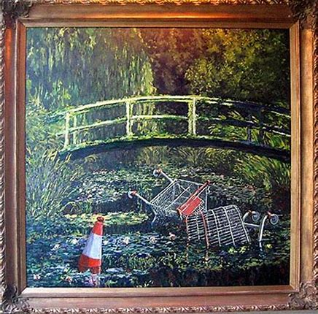
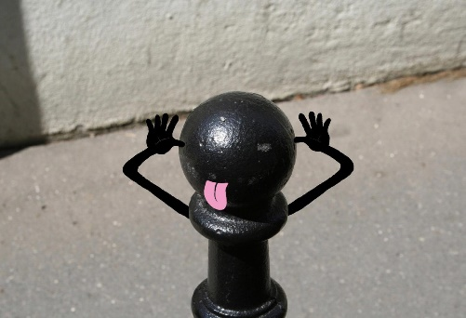
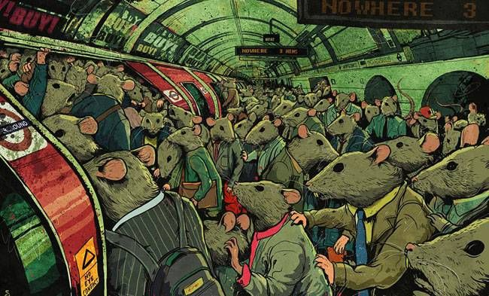
Year 9 Photography
Sorry for the lack of examples of student work. This is due to limited access of physical work.
Project 1
Street Art
Looking at the artists Banksy and Sandrine Boulet with animator Steve Cutts:
Defacing artwork
Creating our own Pareidolia
Depicting a political message in a fun, light hearted way
Lots of editing on Photoshop
Year 9 course is to be enjoyed by practicing and making mistakes. None of the work will impact the overall GCSE only allow students to develop their skills and interests in the subject.

Slide 2
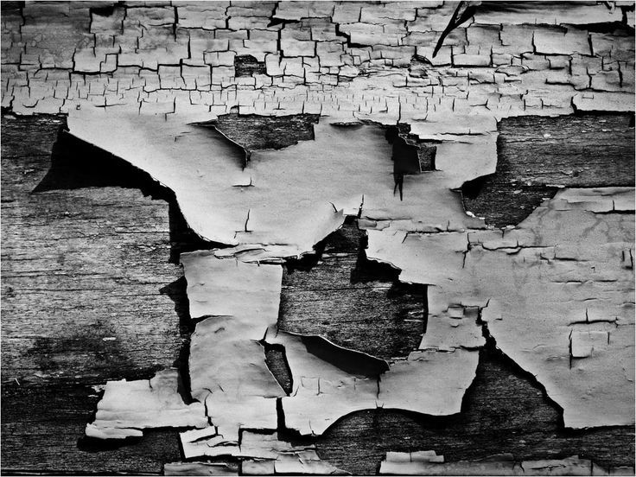
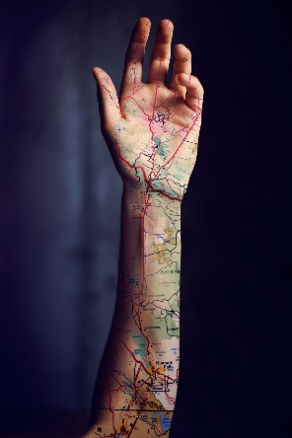
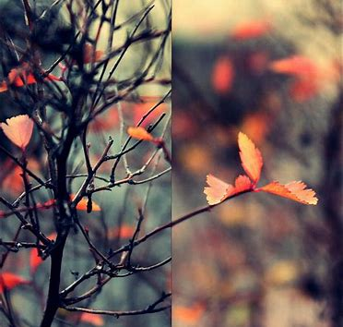
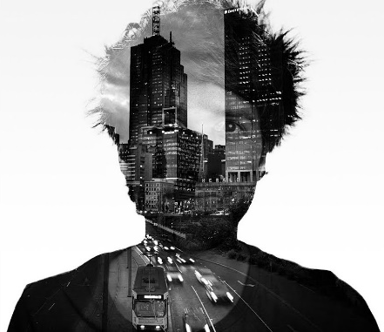
Year 9 Photography
Sorry for the lack of examples of student work. This is due to limited access of physical work.
Project 2
Texture
Learning about key photographic techniques such as:
Macro photography
Depth of field
Overlay
Simple yet important Photoshop editing
More about camera control
Year 9 course is to be enjoyed by practicing and making mistakes. None of the work will impact the overall GCSE only allow students to develop their skills and interests in the subject.

Slide 3
Writing frameworks & help sheets
All the way through year 9 and into the GCSE course framework and help sheets are used to support students. Allowing students to build their subject specific terminology and structure their written work.
Written work is minimal as we try to visually show students understanding through the use of print screened ‘how to’ pages.

Slide 4
GCSE Photography
COURSEWORK 60%
= 3 projects over Yr 10 & 11
Composition
Camera angles
Composition Rules
Photoshop editing
Cinematic Portraiture
3 light studio work
Facial expression & body language
Photoshop and physical editing
Patterns in Nature
Lighting
Mini studios
Trip to Capel Manor
Photoshop and physical editing
EXAM 40%
Title given by exam board (Beginning of January)
Produce coursework (Jan-March)
10 hour exam to create final piece (End of March)

Slide 5
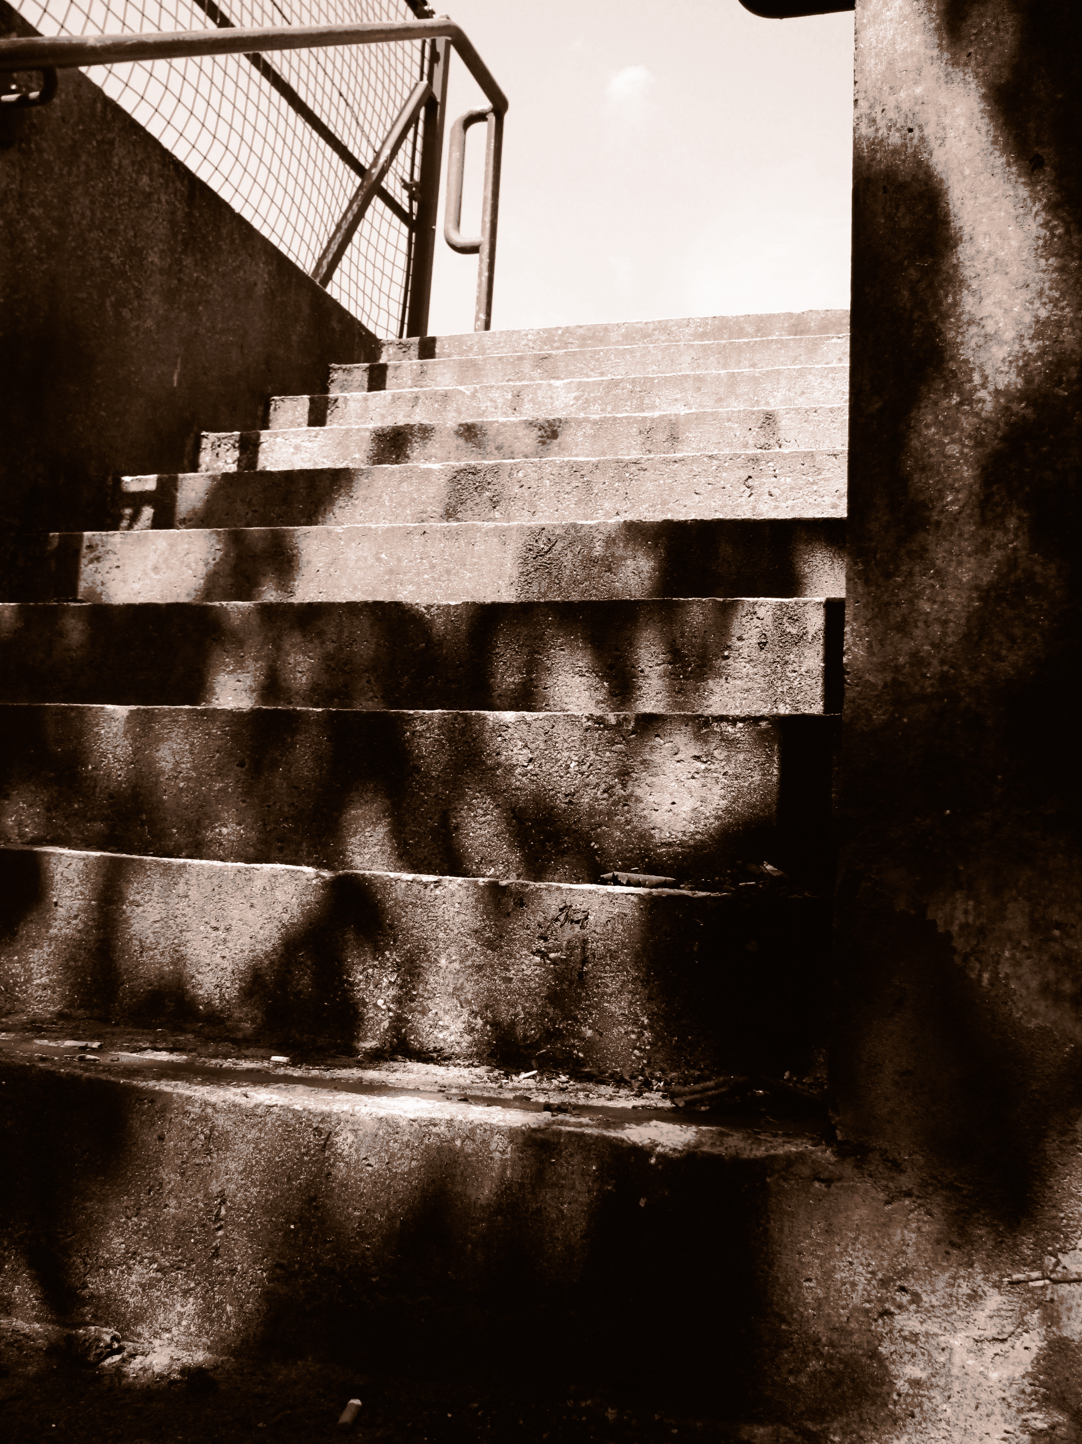
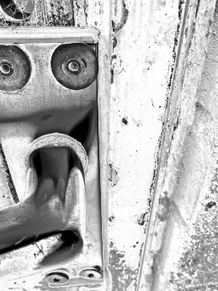
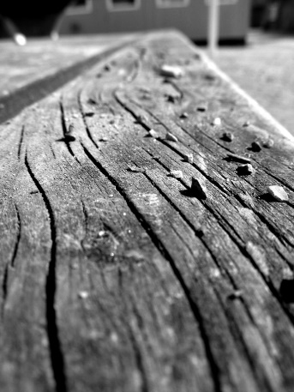
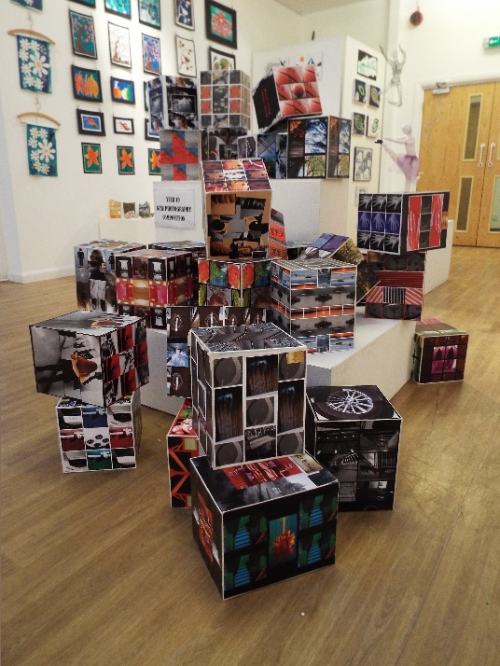
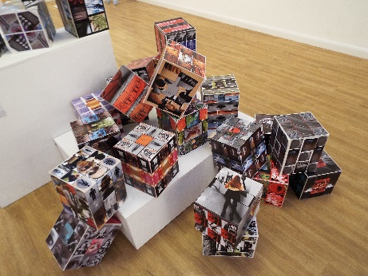
Composition- CW
This project is a skills based that focuses on composition rules and the formal elements, working solely with Photoshop to build skills. Within this project we:
Breakdown the formal elements
Rodchenko- Camera angles
Moholy-Nagy - Diptych
Gilbert & George- Grids and generating a theme behind a piece of work

Slide 6
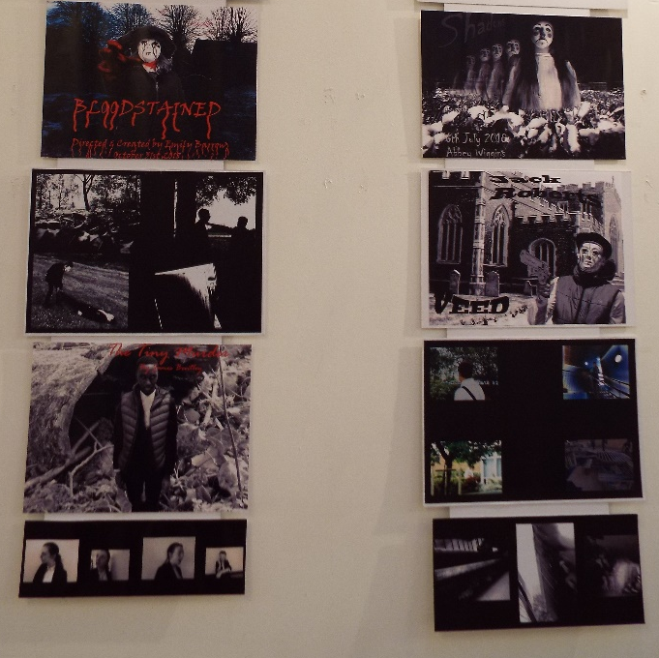
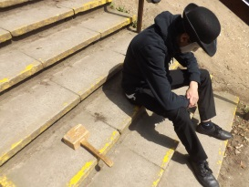
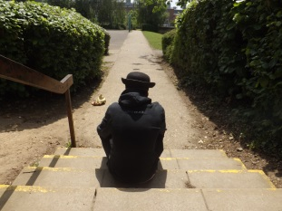
Cinematic Portraiture- CW
This project is portraiture based that focuses on studio work and lighting, working predominantly with Photoshop but with an opportunity of physical editing with things like paint and stitch. Within this project we:
Choose our own film genre to create an original project.
Create our own characters with make-up and props.
Walk round Ware town to get a variety of images to work with.
Look at creating a narrative within a set of photographs.
Artists – Herb Ritts, Cindy Sherman and Tom Hunter

Slide 7
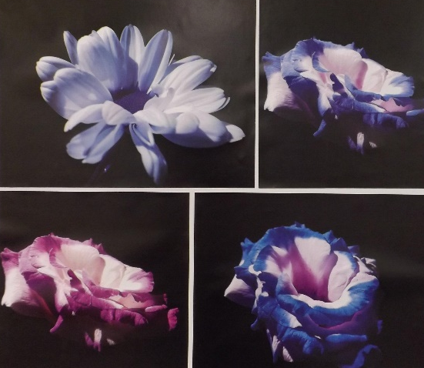
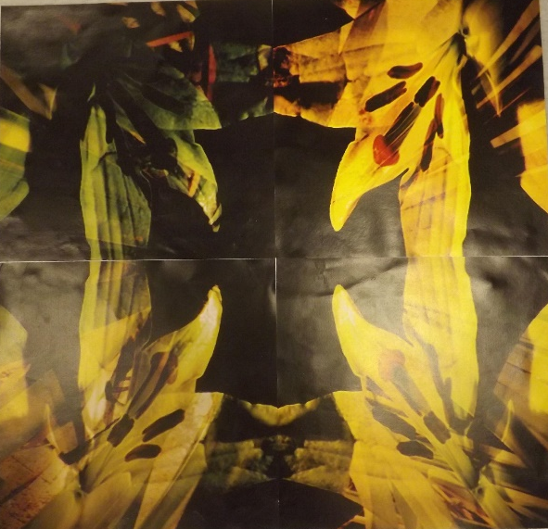
Patterns in Nature - CW
This project is a nature based started with a day trip to Capel Manor. The project focuses on studio work and natural lighting, working predominantly with Photoshop but with an opportunity of physical editing with things like paint and stitch.
Within this project we:
Visit Capel Manor.
Control lighting in studios as well as outside in the environment.
Use this project as a mock exam to get students confident for the real thing.
Artists – Frans Lanting and then two others which students will choose to make their projects more individual.
Examples of what students produce in the 10 hour mock exam.

Slide 8
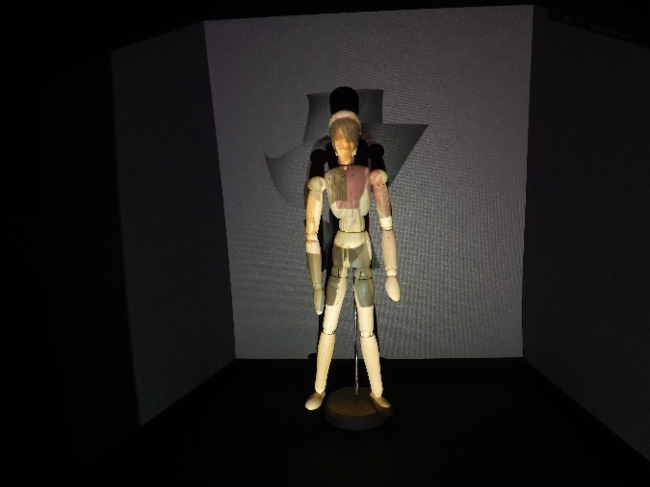
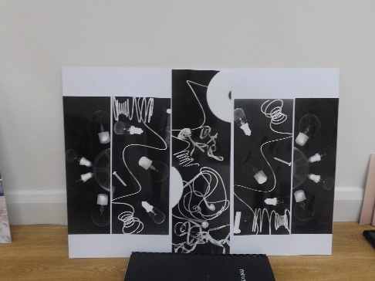
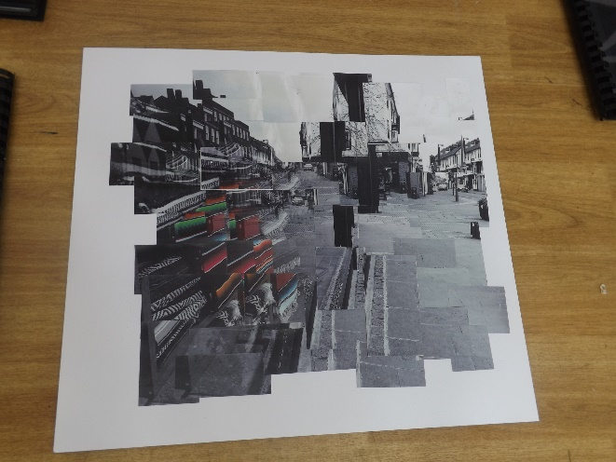
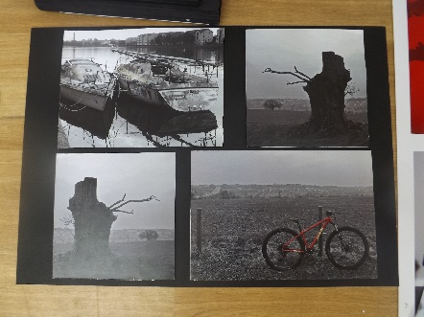
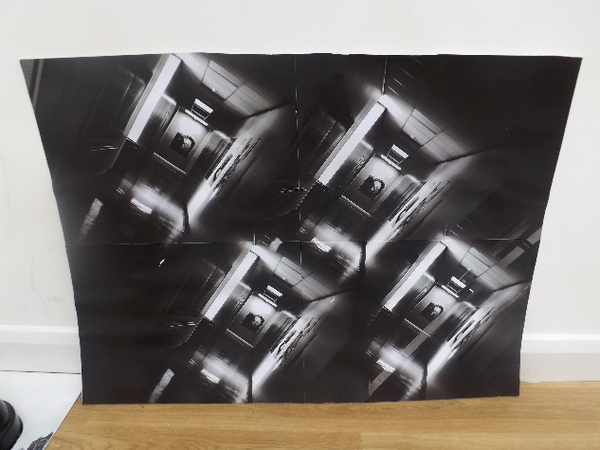
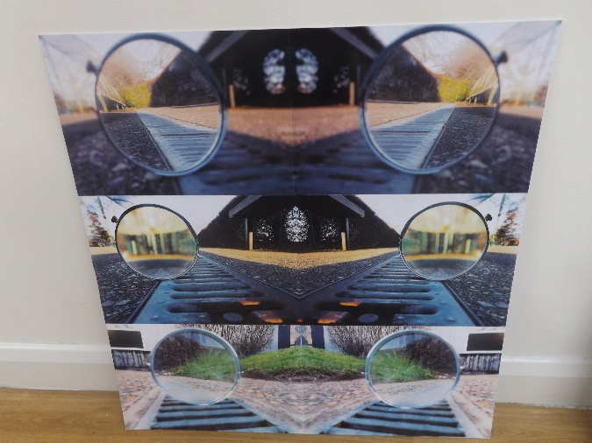
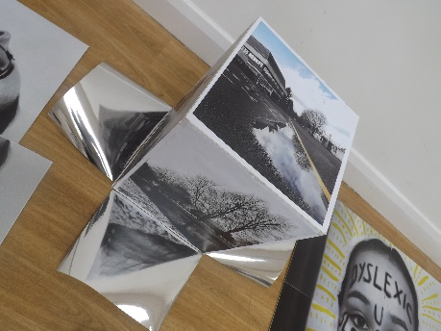
Exam Project Examples
This project’s title is based on what the Exam board sets. There is always a variety of options (normally 7) and work can be completed using editing techniques you prefer and are based on your strengths.

Slide 9
Questions often asked
No you don’t need your own camera. The school has more than enough that you can even take one overnight or for weekend.
There is no homework. We promote the idea to go out and take more photographs if you want to aim for the higher grades in the subject but this is not compulsory.
Your smart phones are getting better and better at taking and editing photographs and if you want to use your phone you can.
You do not need Photoshop at home to work on as all editing can be done in lesson time.
We are proud to be able to say students who take photography achieve at least a level higher than their predicted grade.
Any other questions please do not hesitate to email me at lisa.smith@chauncy.org.uk

