Slide 1
GCSE DRAMA
Eduqas
3 components
(2 practical exams, 1 written exam)

Slide 2
overview
Component 1: Devising Theatre 40%
(creating a piece of drama in a group from a stimulus such as a picture, piece of music, quote or theme This is to be performed to an audience using a practitioner influence)
Component 2 : Performing from a text 20%
(Perform 2 short extracts from a play text in a small group to an audience and a visiting examiner)
Component 3: Interpreting theatre 40%
(Written Exam – study of one play text and a live theatre evaluation)

Slide 3
Why choose drama?
Most lessons are practical
Project and group work
Visits to the theatre
You will be an audience member for other GCSE and A level Drama exams so you can get a feel of what the exam will be like for yourself and see outstanding levels of work from your peers
You will get to explore drama and theatre as a director, actor and designer
It can increase your confidence
You learn skills in drama that are useful in all aspects of life

Slide 4
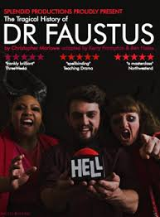
Theatre trips

Slide 5
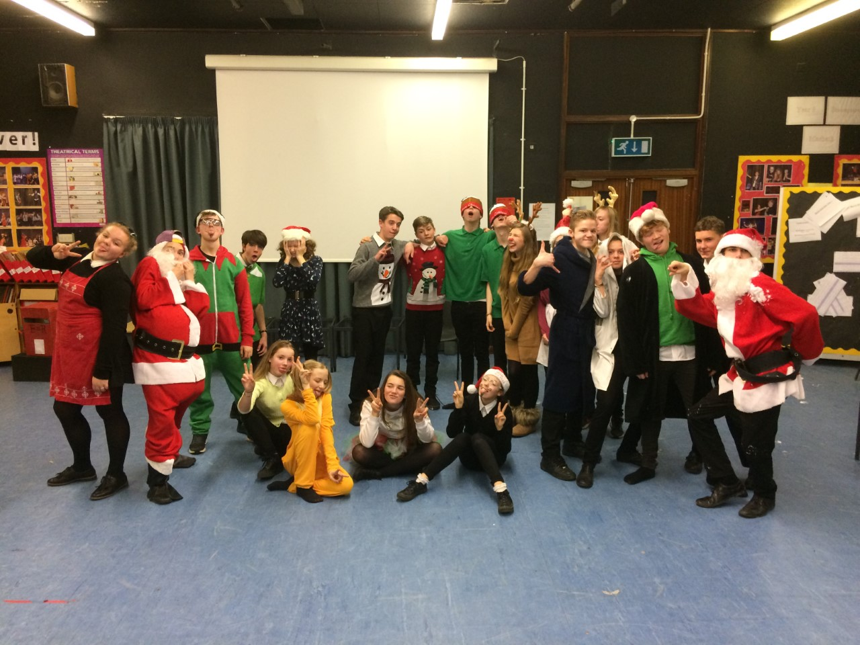
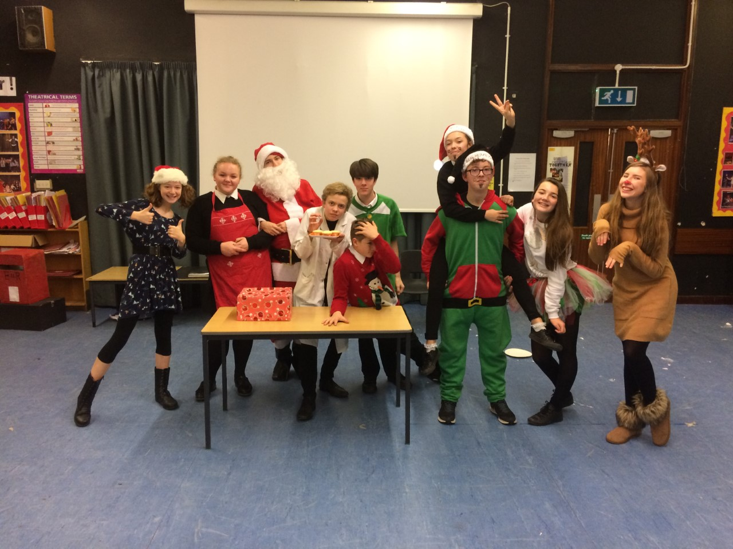
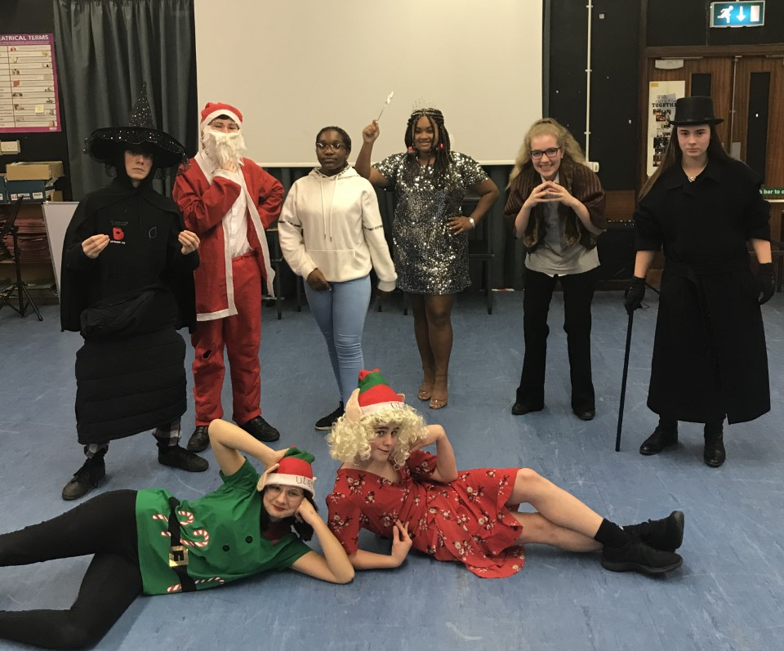
projects
Pantomime primary school tour
Create your own characters and storyline for a pantomime that you will take to primary schools. You also get to choose your own costume and design your sound requirements

Slide 6
projects
Summer showcase
In the summer term students get to develop their performance skills by performing group work to an invited audience with the option of performing an additional monologue or duologue

Slide 7
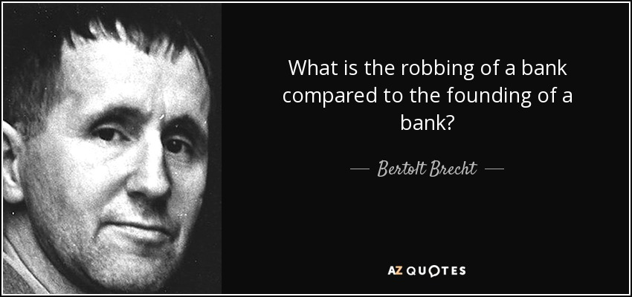
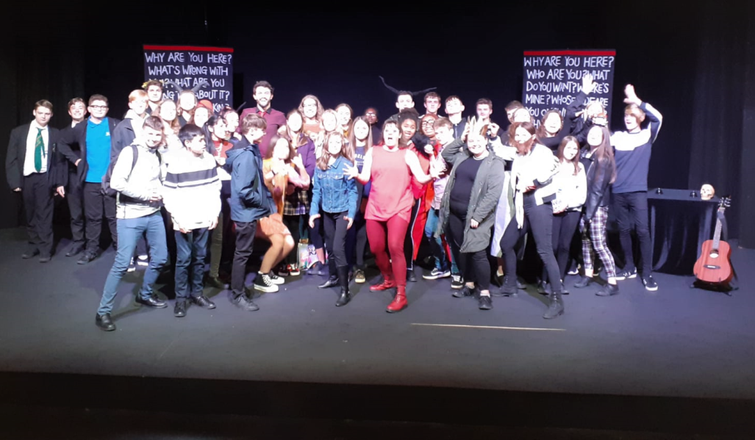
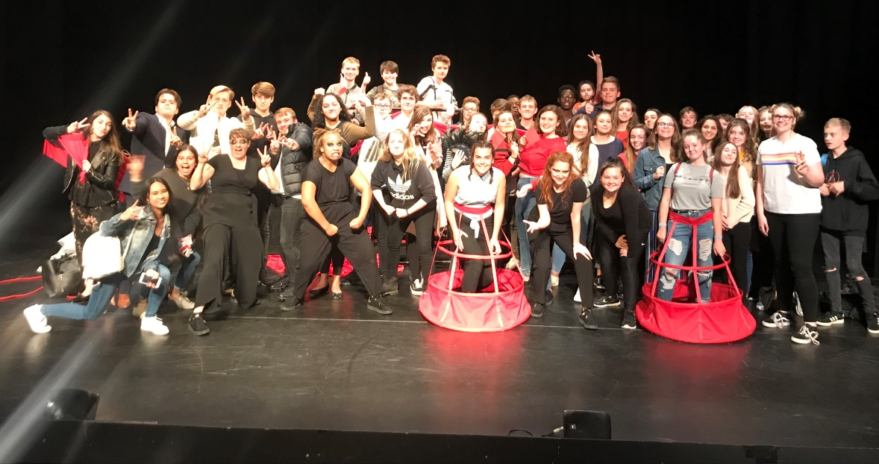
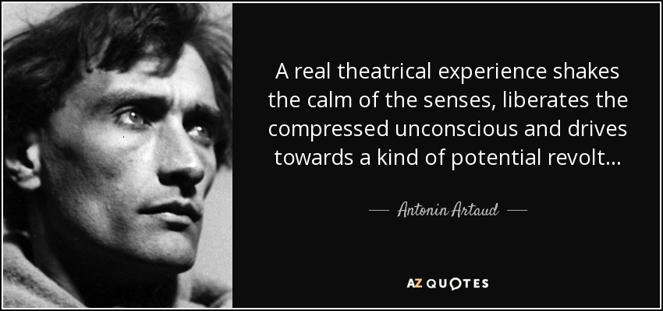
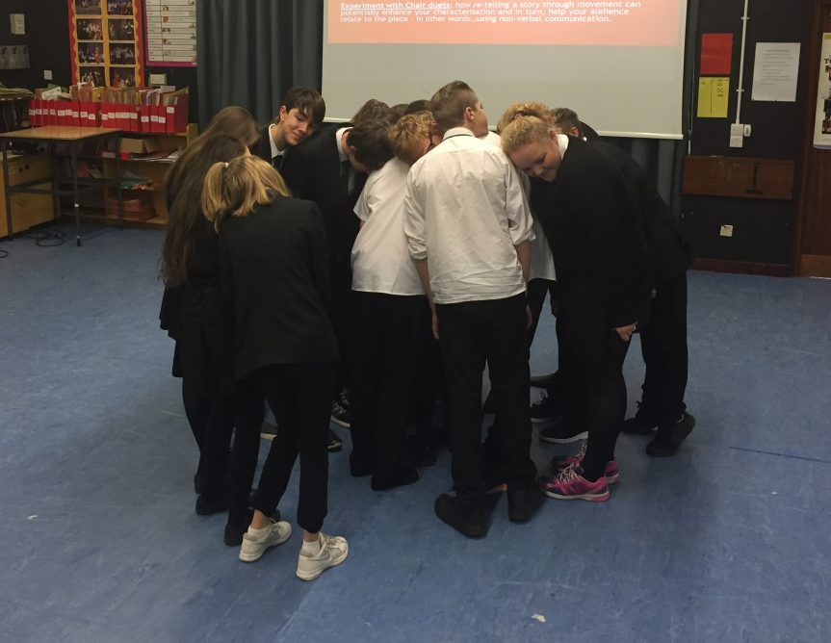
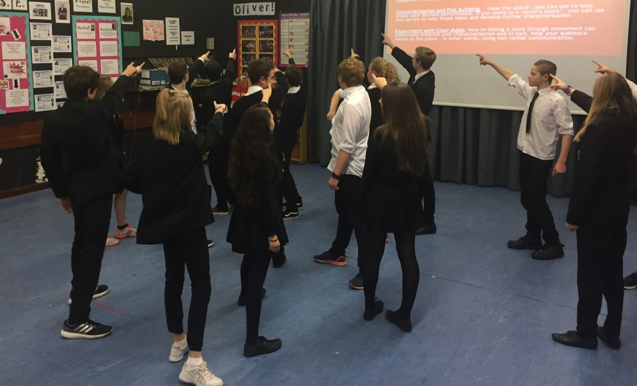
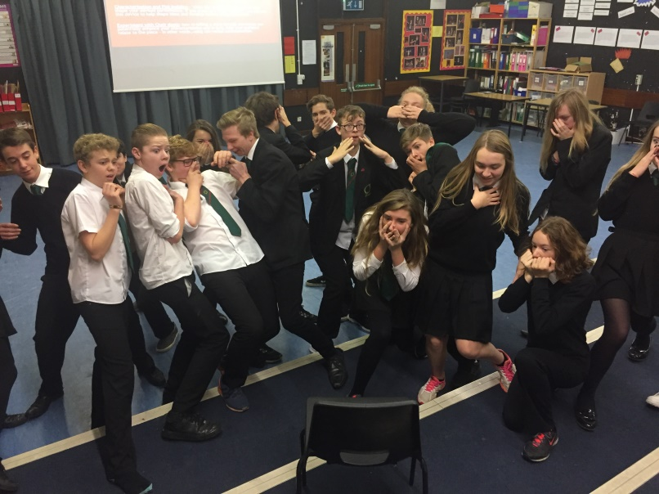
Study of practitioners
What is a practitioner?
These are the pioneers of drama throughout history who have had a major influence in making changes to the way drama and theatre exists throughout the years. Students get to explore each practitioner/theatre company looking at their unique style and then get to choose their favourite to influence the style of their devised piece.
One of our theatre trips is to see a practitioner focused piece and we are sometimes lucky enough to meet the cast.

Slide 8
Do I have to write?
Yes
There is a portfolio and evaluation to complete to support the performance in component 1
There is the 1hour 30 minutes written exam for component 3.
Although this is a highly practical subject there is an element of writing within the duration of the course.

Slide 9
Component 1
40% Devising Theatre
This is a group project where together you will create a piece of drama between 9-14 minutes long from the starting point (stimulus) of a photo, piece of music, quote or theme.
Your piece will be influence by a practitioner of your choice.

Slide 10
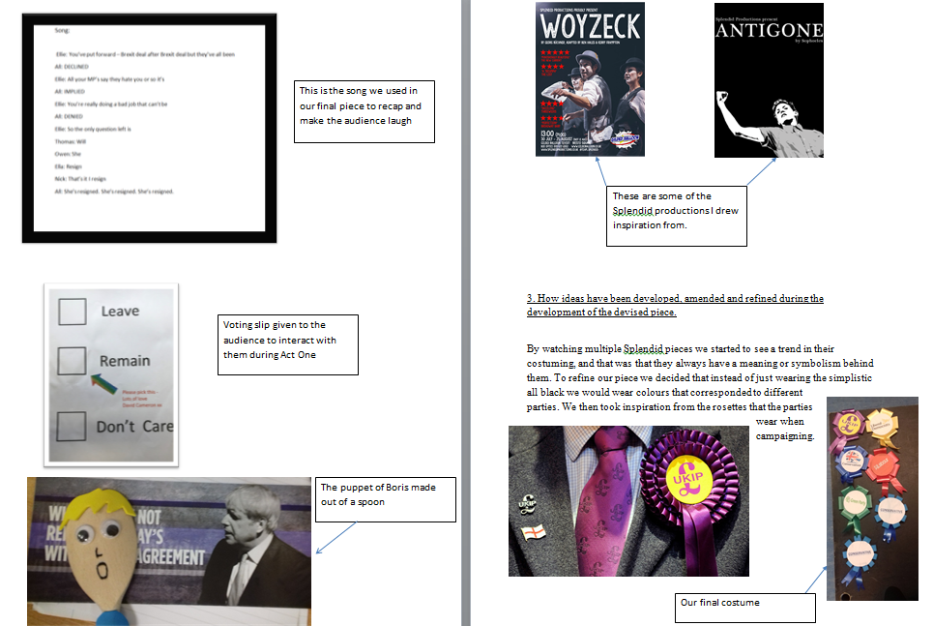
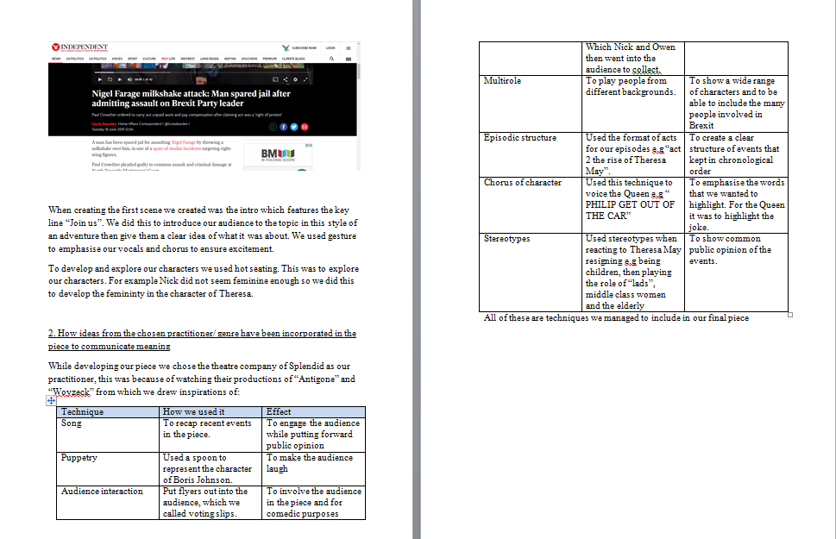
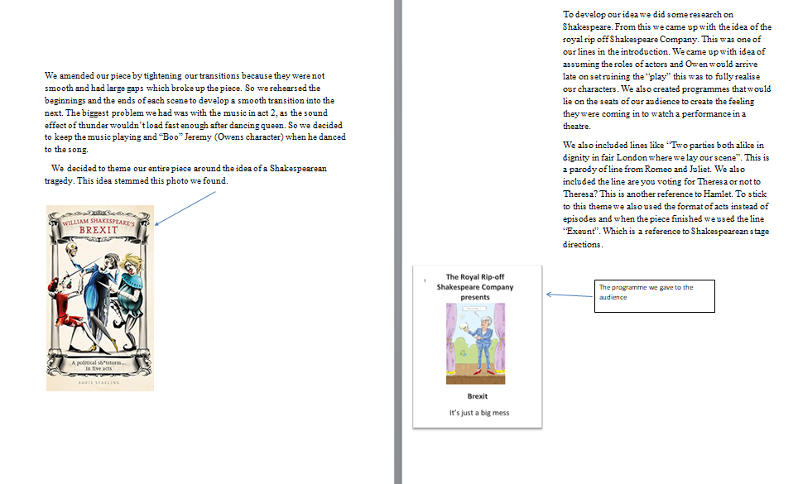
Component 1- written work
This component also requires a supporting portfolio which focuses on key moments of the process and you are encouraged to use photographs, grids and diagrams to help show the creativity.
Maximum 900 words.
In addition to this, you will also have to complete an 1 hour 30 controlled assessment after the exam to complete an evaluation of the performance. No word limit – just what you can complete in the allocated time.

Slide 11
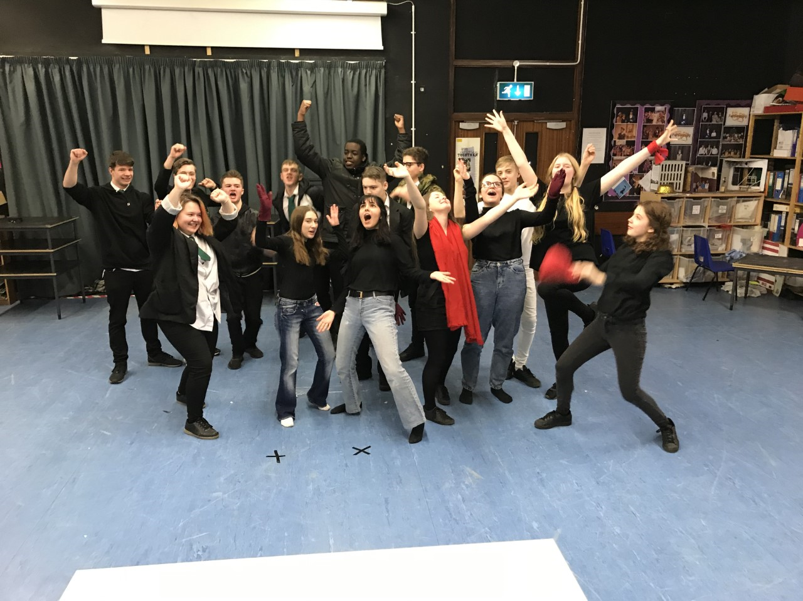
Component 2
20% Performing from a text
For this component you have to explore, learn and perform a role for performance in small groups. You have to perform 2 short extracts from the same play which is performed to an audience and an external examiner.

Slide 12
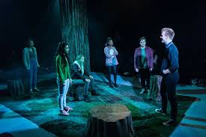
Component 3
40% Interpreting theatre
Although this is preparation for the written exam – this is mostly taught practically. The questions in the exam ask you to think as either an actor, a director or a designer so we therefore have to explore the play practically to do this. We explore the play as an actor by playing the roles, as a director by exploring practical rehearsal techniques which help us to understand the character or the themes within the play better and as a designer by experimenting with the lighting, sound, staging and costume designing.
The exam questions can range from 1 mark to 15 minutes and after the ideas are explored practically – I then translate how to adapt what we have just done practically and turn it into a written question and answer. This is completed as a plenary exercise, a homework exercise or a following starter activity.
The second part of the exam is reviewing a piece of theatre which is covered in detail after our visit to the theatre.

Slide 13
Is this the course for you?
If you enjoy practical work, performing, being creative, working collaboratively, going to the theatre, exploring plays and character or have an interest in the ‘behind the scenes’ in the world of theatre…
…….then this is the course for you.

