Slide 1
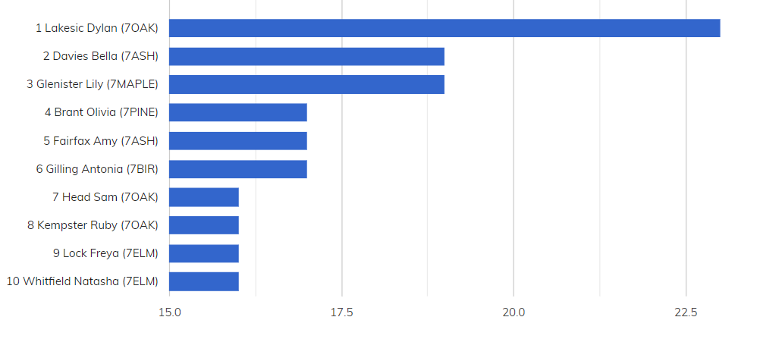
YEAR SEVEN BRONZE AWARDS

Slide 2
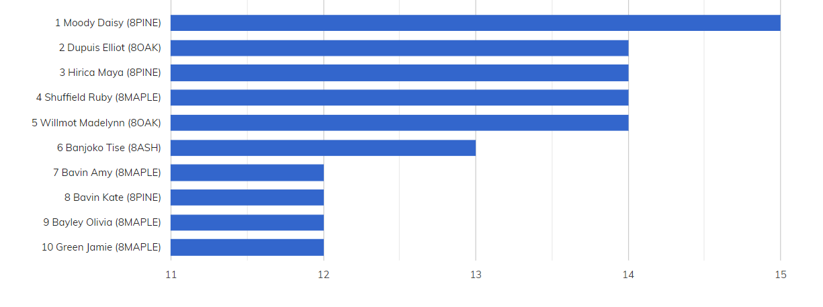
YEAR EIGHT BRONZE AWARDS

Slide 3
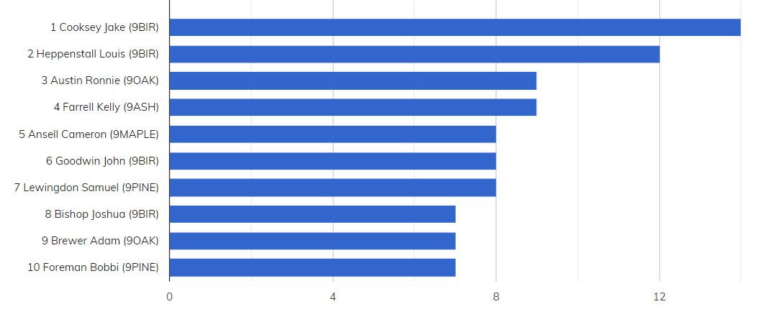
YEAR NINE BRONZE AWARDS

Slide 4
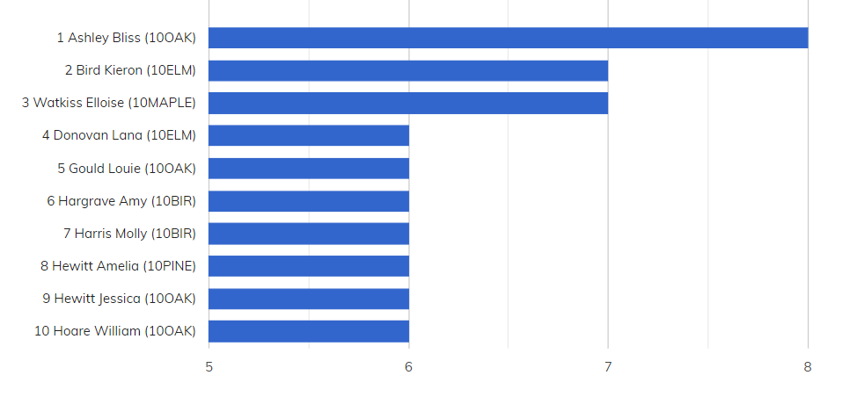
YEAR TEN BRONZE AWARDS

Slide 5
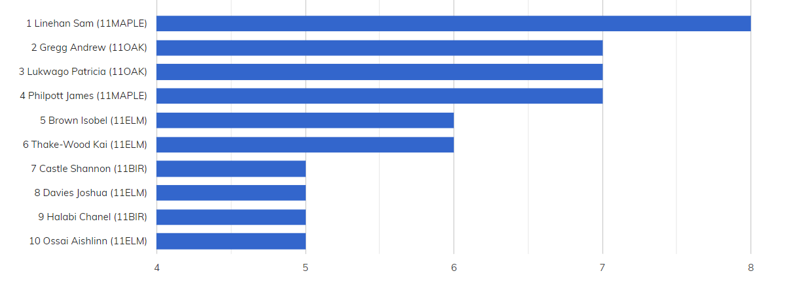
YEAR ELEVEN BRONZE AWARDS
None this week
This academic year

Slide 6
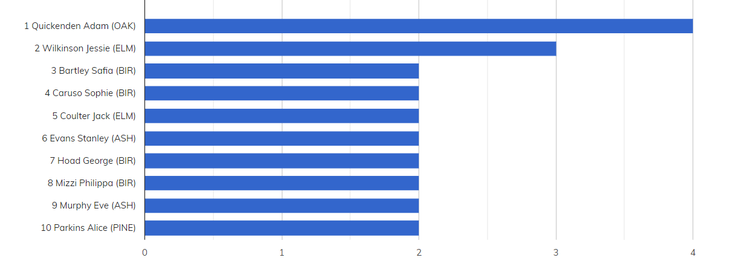
YEAR TWELVE BRONZE AWARDS
None this week

Slide 7
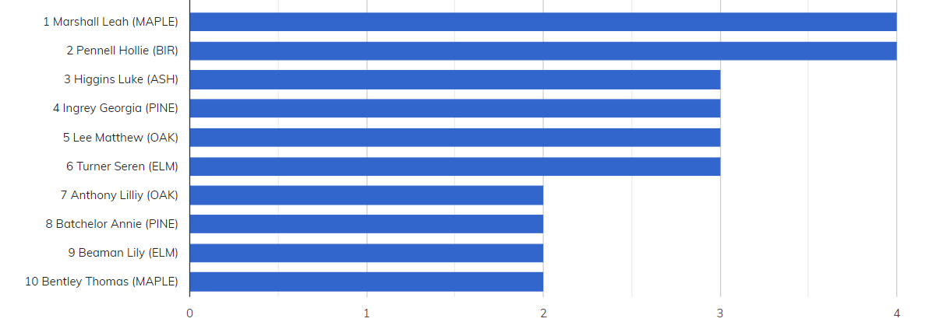
YEAR THIRTEEN BRONZE AWARDS
None this week
This academic year

Slide 8
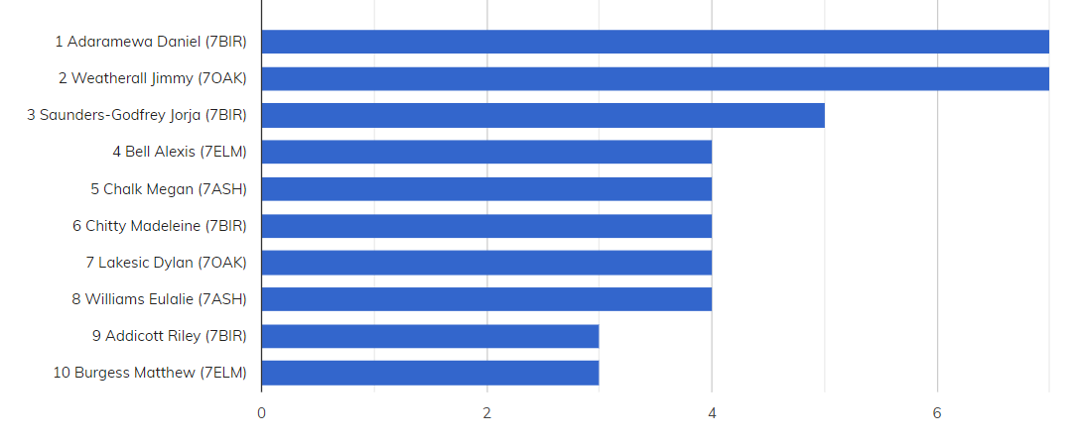
YEAR SEVEN SILVER AWARDS

Slide 9
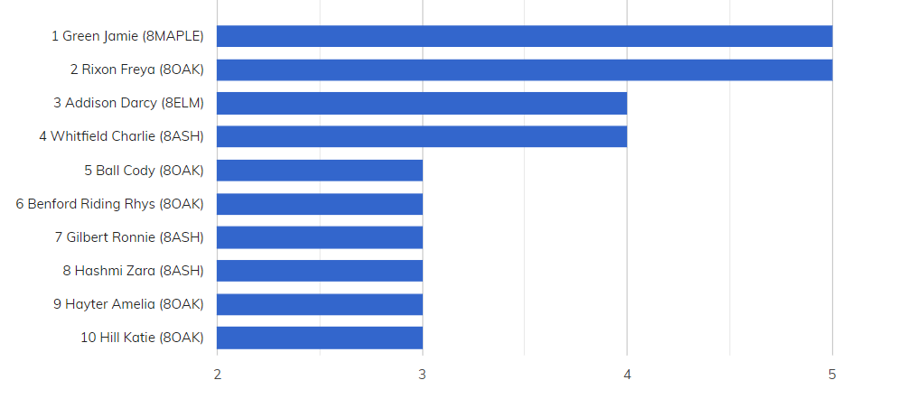
YEAR EIGHT SILVER AWARDS

Slide 10
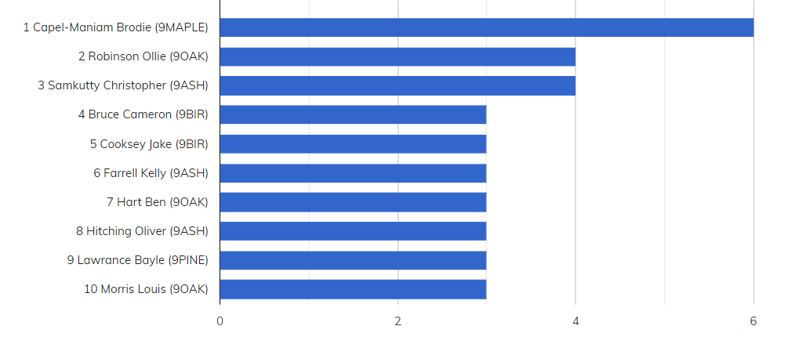
YEAR NINE SILVER AWARDS

Slide 11
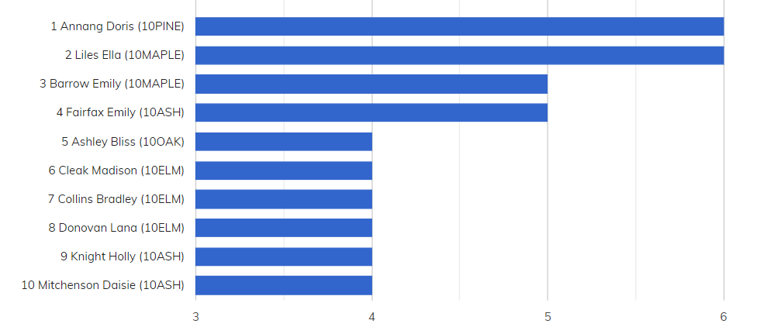
YEAR TEN SILVER AWARDS
Exam week

Slide 12
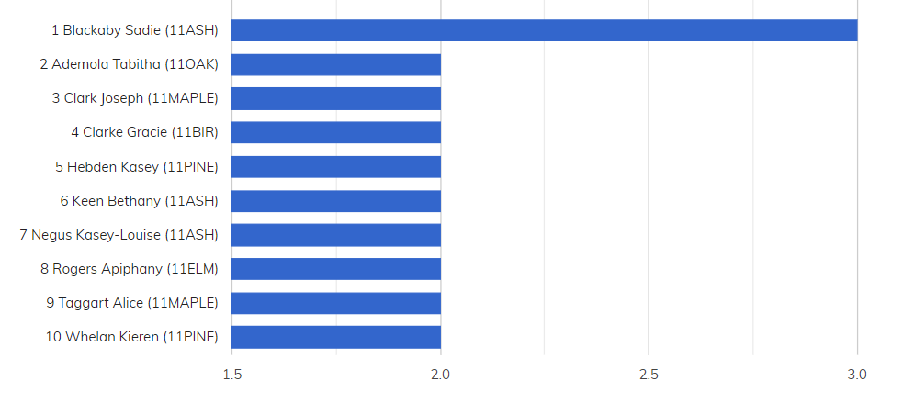
YEAR ELEVEN SILVER AWARDS
None this week
This academic year

Slide 13
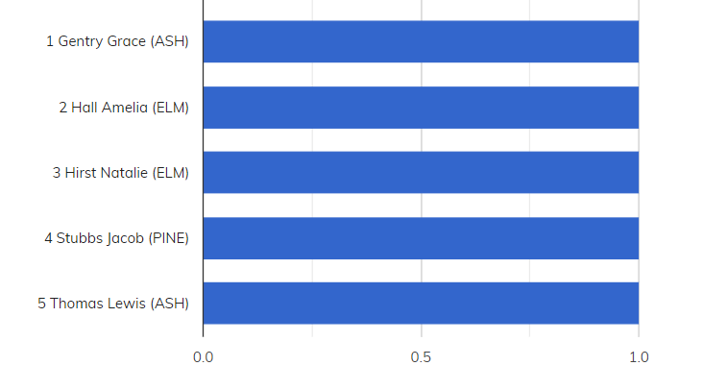
YEAR TWELVE SILVER AWARDS
None this week
This academic year

Slide 14
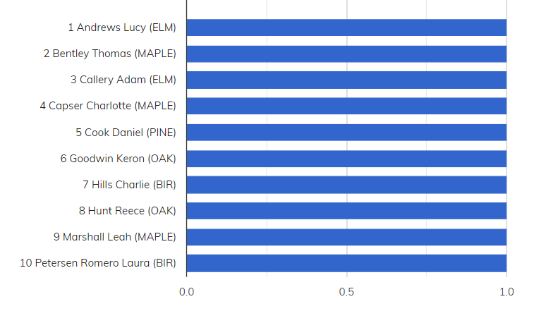
YEAR THIRTEEN SILVER AWARDS
None this week

Slide 15
GOLD AWARDS
Allen Henry (7BIR) 1
Baker Sonny (10BIR) 1
Burgess Fifi (7PINE) 1
Burgess Matthew (7ELM) 1
Chalk Megan (7ASH) 1
Cleak Madison (10ELM) 1
Cooke Sophie (10BIR) 1
Fairfax Emily (10ASH) 1
Gregg Andrew (11OAK) 1
Hirica Maya (8PINE) 1
Lane Millie (7MAPLE) 1
Ling Haydn (10OAK) 1
Martin Emily (10ASH) 1
Moody Daisy (8PINE) 1
Sherman Bill (7BIR) 1
York Matthew (7ASH) 1

Slide 16
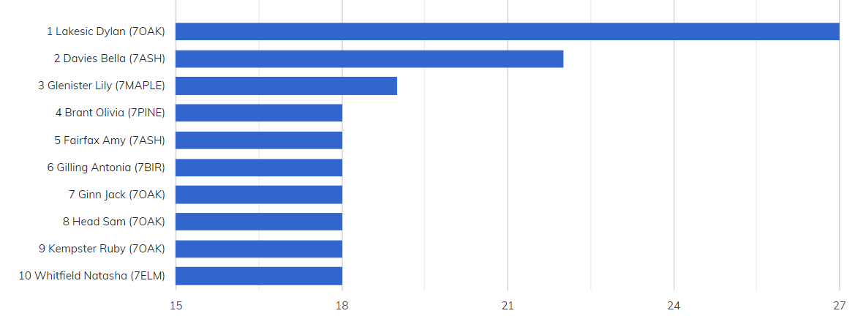
TOP TEN CHAUNCY AWARDS (NO OF SLIPS) YEAR SEVEN

Slide 17
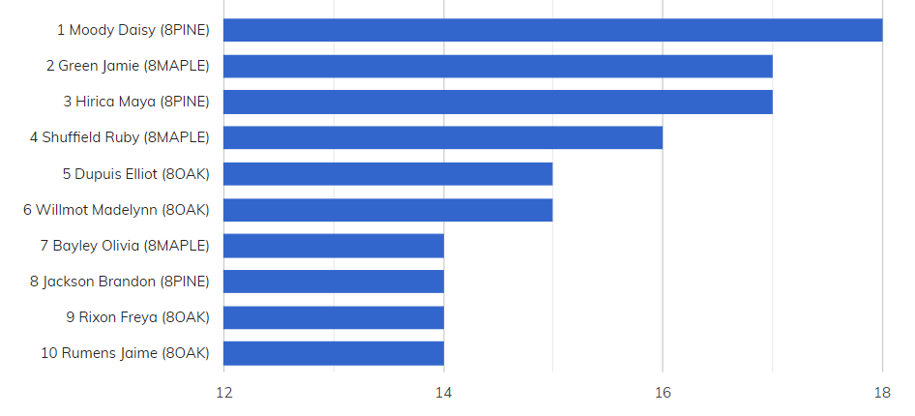
TOP TEN CHAUNCY AWARDS (NO OF SLIPS) YEAR EIGHT

Slide 18
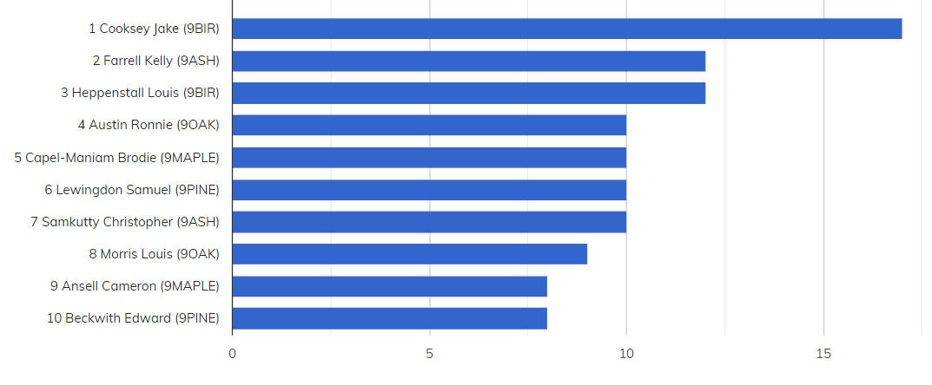
TOP TEN CHAUNCY AWARDS (NO OF SLIPS) YEAR NINE

Slide 19
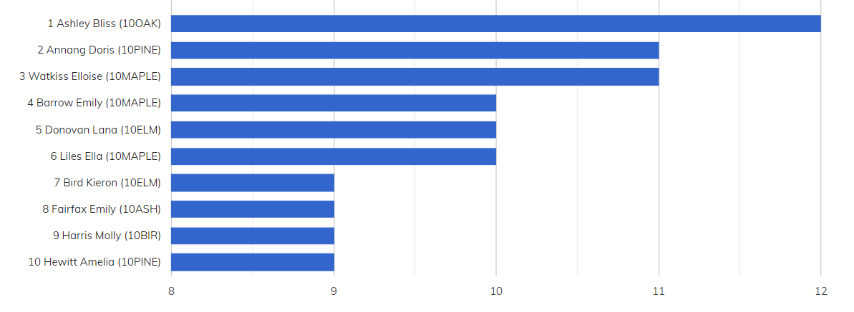
TOP TEN CHAUNCY AWARDS (NO OF SLIPS) YEAR TEN

Slide 20
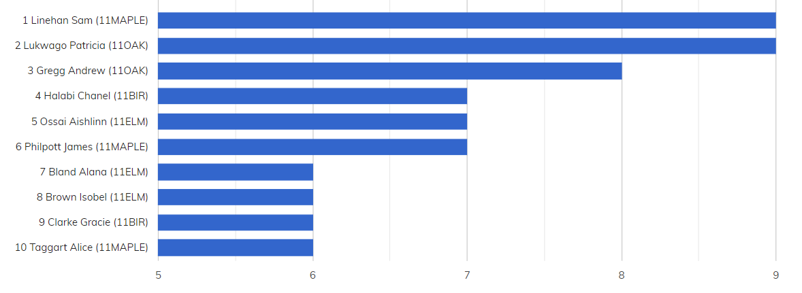
TOP TEN CHAUNCY AWARDS (NO OF SLIPS) YEAR ELEVEN
This academic year

Slide 21
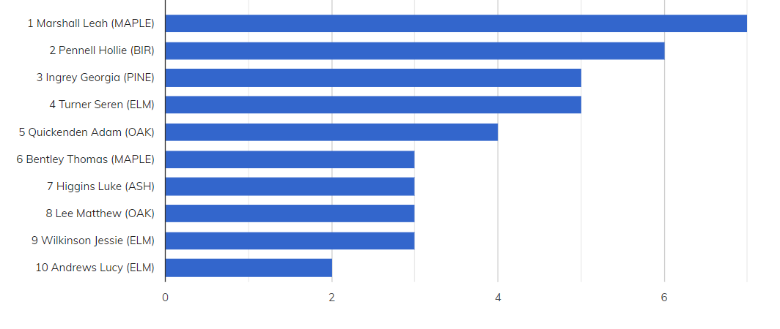
TOP TEN CHAUNCY AWARDS (NO OF SLIPS) SIXTH FORM
This academic year

Slide 22
CHAUNCY ACHIEVEMENTS
Allen Henry (7BIR) 1
Ambler Lewis (8PINE) 1
Atkinson Molly (7ASH) 1
Clark Nate (7BIR) 1
Clarke Madeleine (7ASH) 1
Coates Kane (7MAPLE) 1
Cook Holly (7OAK) 1
Cox Olivia (8MAPLE) 1
Eagle Ella-Rose (7BIR) 1
Fisher Lauren (8OAK) 1
Furze Daisy (8ELM) 1
Gafney Daisy (7ASH) 1
Gentry Madison (8OAK) 1
Ginn Jack (7OAK) 1
Greene Asha (7ASH) 1
Hammond Kayleigh (8BIR) 1
Hankin George (8OAK) 1
Hashmi Zara (8ASH) 1
Healy Luke (8BIR) 1
Hunt Jennifer (7MAPLE) 1
Hutchins Victoria (7PINE) 1
Ince Leyla (7BIR) 1
Kempster Ruby (7OAK) 1
Kenny Max (7BIR ) 1
Kinloch Niamh (8ASH) 1
Landeira Samuel (8ASH) 1
List Frederick (8BIR) 1
Millhouse Samuel (7ELM) 1
Robertson Thomas (8MAPLE) 1
Russell Erin (7OAK) 1
Shepherd Emma (8MAPLE) 1
Southwell Erin (8BIR) 1
Steele Albi (8PINE) 1
Straker Jade (8BIR) 1
Swindale Megan (8ASH) 1
Tancock Matthew (7BIR) 1
Thornton Emily (7ASH) 1
White Scott (8PINE) 1
White Sophie (7BIR) 1
Whitfield Charlie (8ASH) 1
Whitfield Natasha (7ELM) 1

