Slide 1
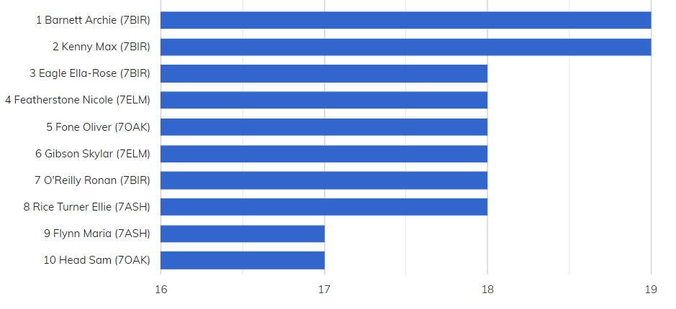
YEAR SEVEN BRONZE AWARDS

Slide 2
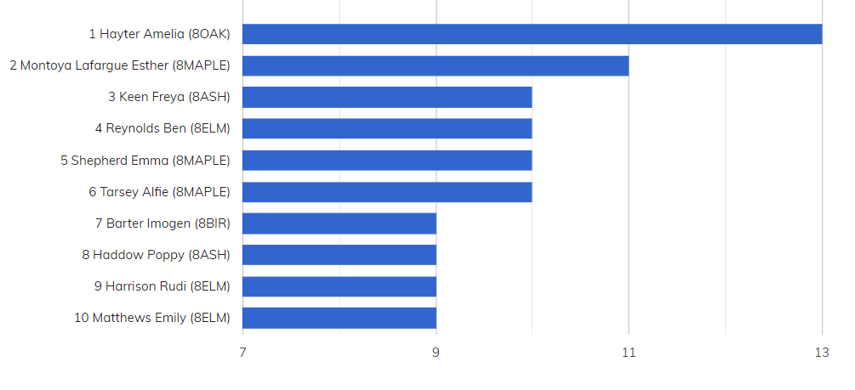
YEAR EIGHT BRONZE AWARDS

Slide 3
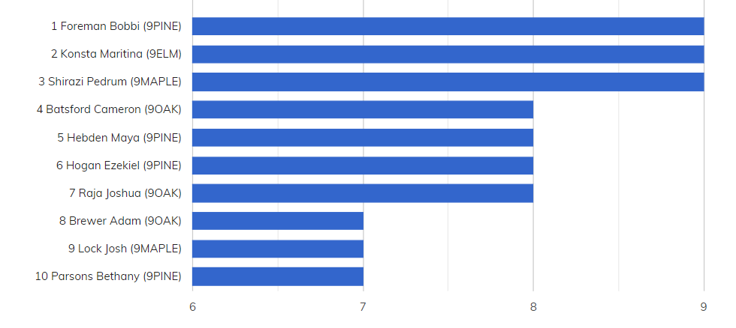
YEAR NINE BRONZE AWARDS

Slide 4
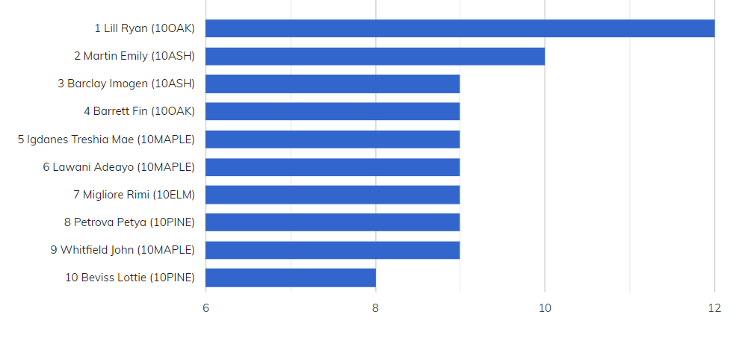
YEAR TEN BRONZE AWARDS

Slide 5
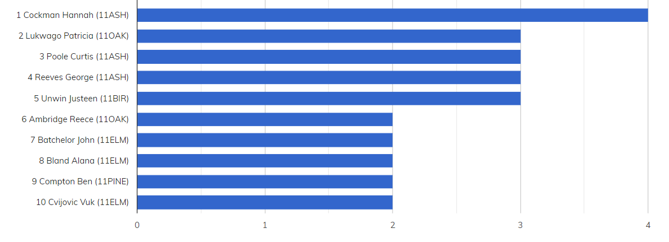
YEAR ELEVEN BRONZE AWARDS
This academic year

Slide 6
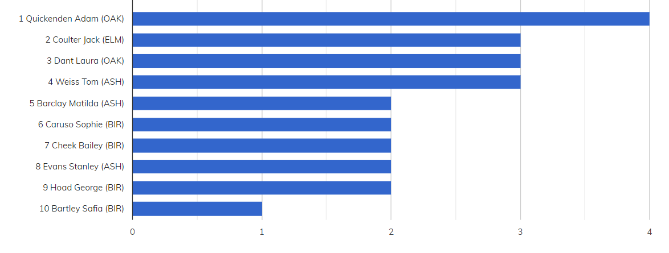
YEAR TWELVE BRONZE AWARDS
None this week

Slide 7
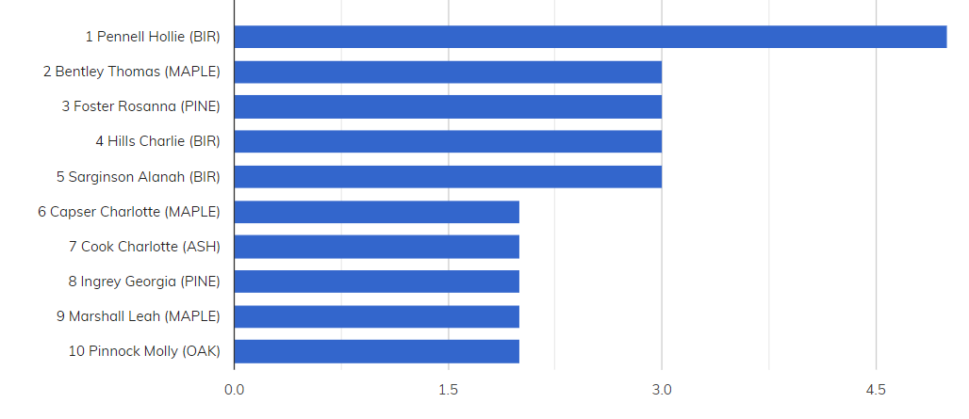
YEAR THIRTEEN BRONZE AWARDS
None this week
This academic year

Slide 8
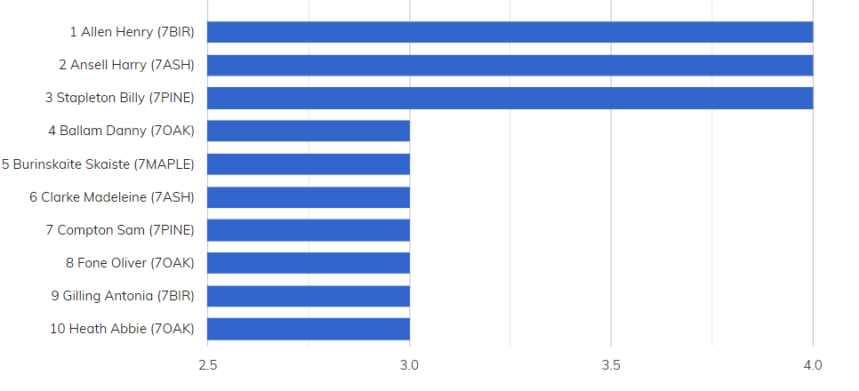
YEAR SEVEN SILVER AWARDS

Slide 9
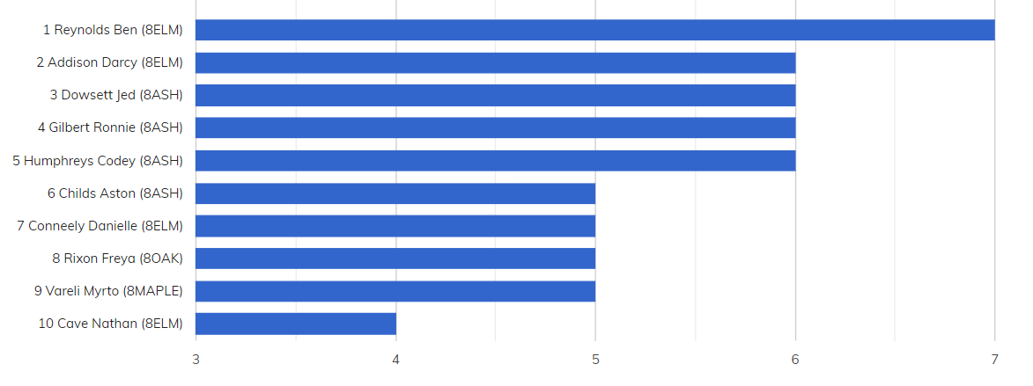
YEAR EIGHT SILVER AWARDS

Slide 10
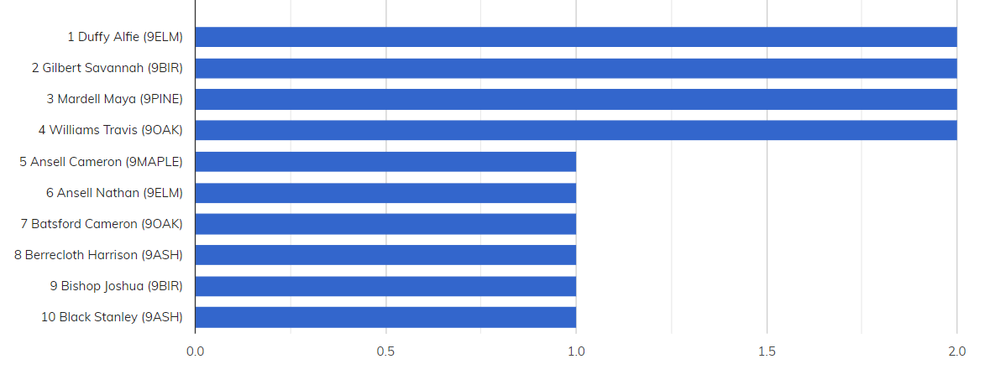
YEAR NINE SILVER AWARDS

Slide 11
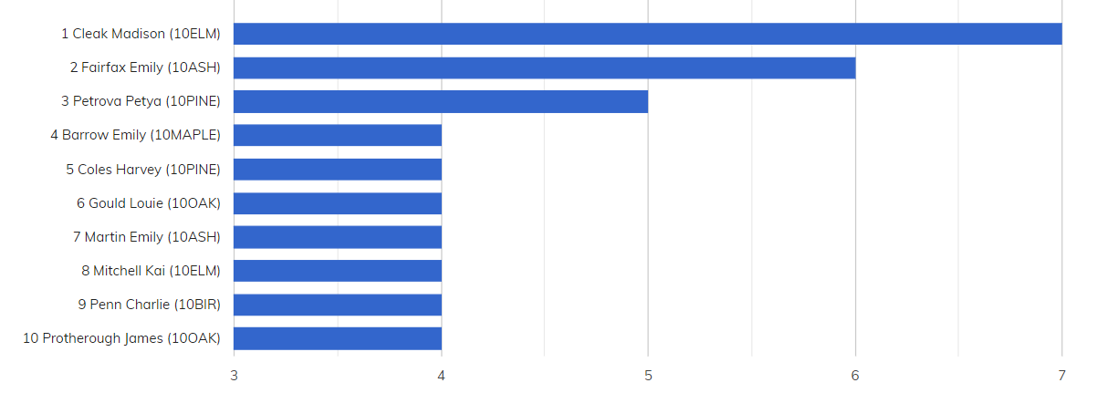
YEAR TEN SILVER AWARDS
Exam week

Slide 12
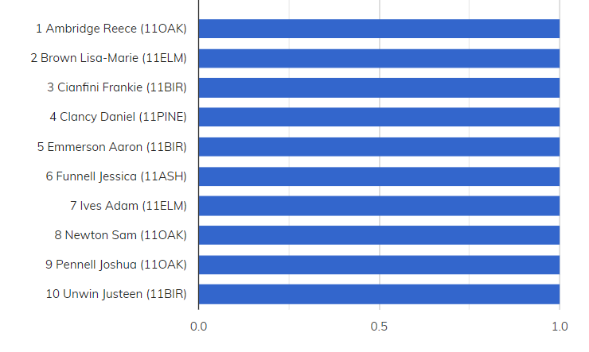
YEAR ELEVEN SILVER AWARDS
None this week
This academic year

Slide 13
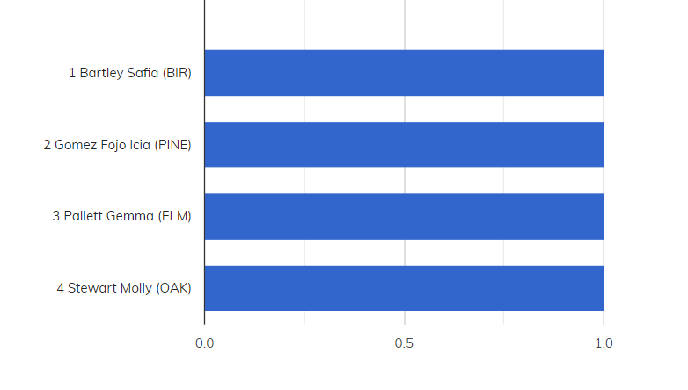
YEAR TWELVE SILVER AWARDS
None this week
This academic year

Slide 14
YEAR THIRTEEN SILVER AWARDS
None this week

Slide 15
GOLD AWARDS
Russell Erin (7OAK) 2
Atkinson Molly (7ASH) 1
Austin Frankie (7MAPLE) 1
Bevan Joel (11ELM) 1
Bridgeman Sophie (7ELM) 1
Cheek Lotty (8BIR) 1
Chuter Millie (7ELM) 1
Duke Sophie (7ELM) 1
Eagle Ella-Rose (7BIR) 1
Featherstone Nicole (7ELM) 1
Flynn Maria (7ASH) 1
Gilling Antonia (7BIR) 1
Grace-Gibbs Joshua (7PINE) 1
Head Sam (7OAK) 1
Hewlett Callum (7ELM) 1
Kenny Max (7BIR) 1
Middleton Rowan (7MAPLE) 1
Moxham Millie (7ELM) 1
Paris Bladen (7PINE) 1
Petchey Amy (7OAK) 1
Porch Scarlett (7MAPLE) 1
Quinlan Henry (7OAK) 1
Rice Turner Ellie (7ASH) 1
Sherman Bill (7BIR) 1
Smith Lily (7PINE) 1
Stewart Dylan (7ASH) 1
Tancock Matthew (7BIR) 1
Thornton Emily (7ASH) 1
White Sophie (7BIR) 1
Whitfield Natasha (7ELM) 1
Whittick Keira (8ELM) 1

Slide 16
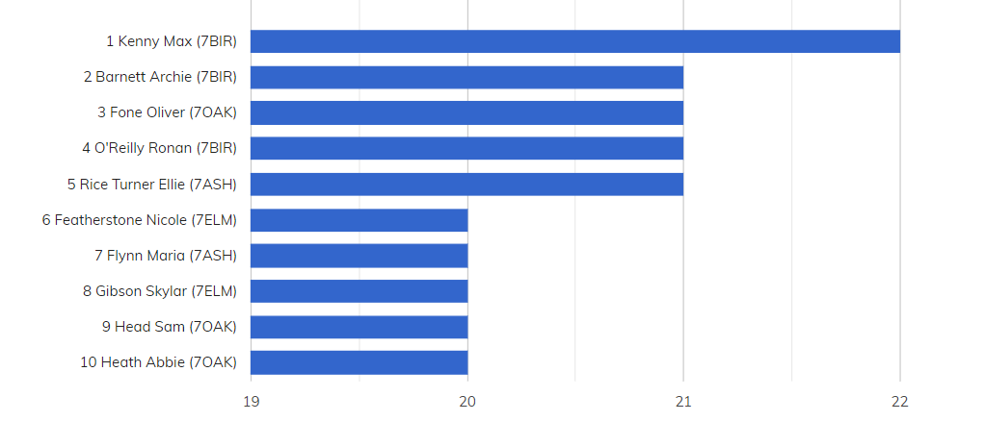
TOP TEN CHAUNCY AWARDS (NO OF SLIPS) YEAR SEVEN

Slide 17
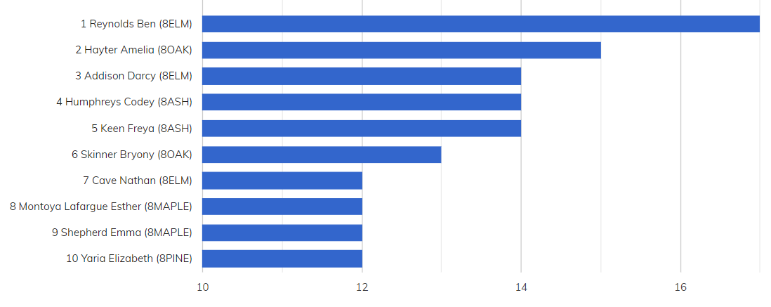
TOP TEN CHAUNCY AWARDS (NO OF SLIPS) YEAR EIGHT

Slide 18
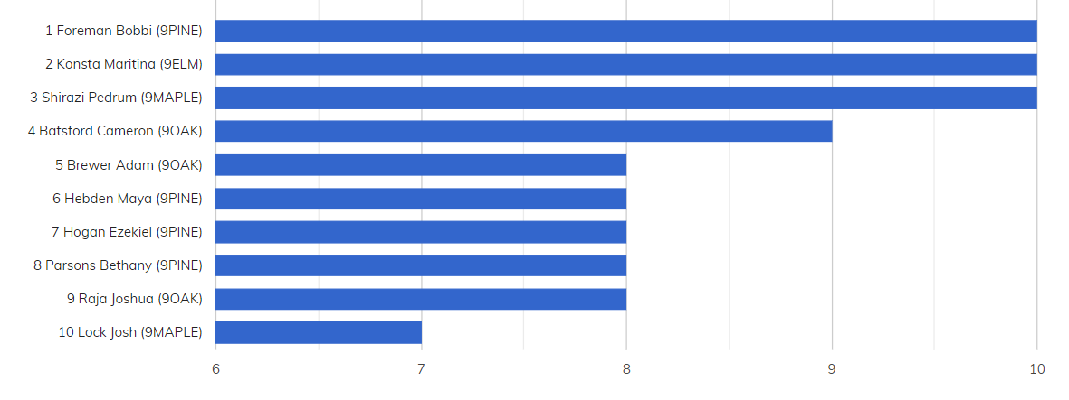
TOP TEN CHAUNCY AWARDS (NO OF SLIPS) YEAR NINE

Slide 19
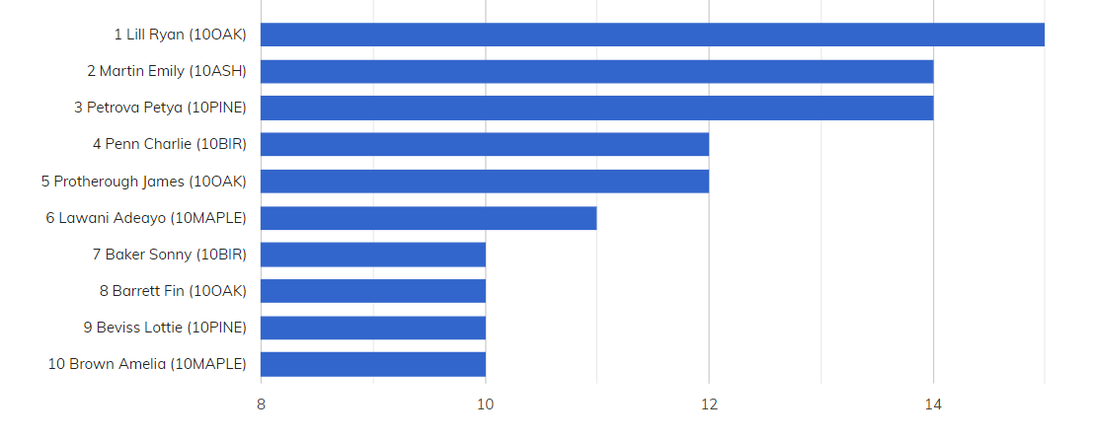
TOP TEN CHAUNCY AWARDS (NO OF SLIPS) YEAR TEN

Slide 20
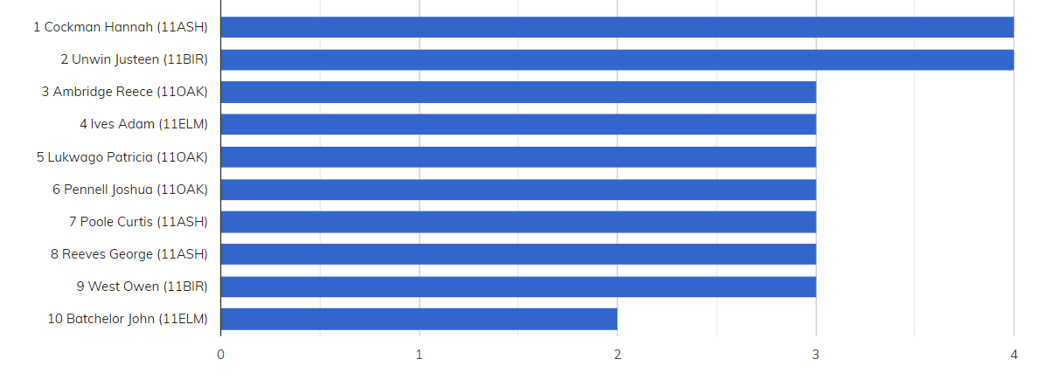
TOP TEN CHAUNCY AWARDS (NO OF SLIPS) YEAR ELEVEN
This academic year

Slide 21
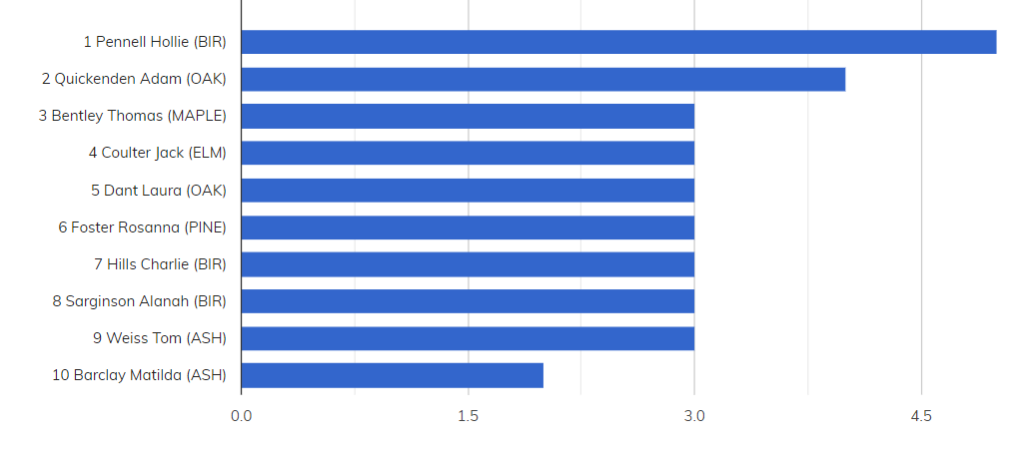
TOP TEN CHAUNCY AWARDS (NO OF SLIPS) SIXTH FORM
This academic year

Slide 22
CHAUNCY ACHIEVEMENTS
Barter Imogen (8BIR) 3
Steele Albi (8PINE) 3
White Scott (8PINE) 3
Yaria Elizabeth (8PINE) 3
Addison Darcy (8ELM) 2
Ambler Lewis (8PINE) 2
Cakebread Lara (8BIR) 2
Hooper Emily (8PINE) 2
Leadbetter Owen (8PINE) 2
Moody Daisy (8PINE) 2
Nunn Alexander (8PINE) 2
Parker Ronja (8ASH) 2
Saboo Pratyush (8MAPLE) 2
Shepherd Emma (8MAPLE) 2
Abello Alfie (8OAK) 1
Akinfenwa Shanumi (8PINE) 1
Aldridge Connor (8ELM) 1
Ball Cody (8OAK) 1
Barnaby Oliver (8ASH) 1
Bavin Kate (8PINE) 1
Blanche-Drammeh Romarlla (8PINE) 1
Bridgeman Sophie (7ELM) 1
Cave Nathan (8ELM) 1
Cheek Lotty (8BIR) 1
Church Imogen (7MAPLE) 1
Clark Archibald (8PINE) 1
Clarke Madeleine (7ASH) 1
Compton Sam (7PINE) 1
Cox Olivia (8MAPLE) 1
Cracknell Harry (8ELM) 1
Cracknell Harvey (8ELM) 1
Donger Samuel (9ELM) 1
Evans Sonny (8PINE) 1
Fairfax Amy (7ASH) 1
Featherstone Nicole (7ELM) 1
Fells Bethany (8BIR) 1
Fisher Lauren (8OAK) 1
Furze Daisy (8ELM) 1
Gale Amy-Louise (8OAK) 1
Gardiner Ben (8OAK) 1
Glenister Lily (7MAPLE) 1
Haddow Poppy (8ASH) 1
Hamilton-Thompson Tiffany (7PINE) 1
Hammond Kayleigh (8BIR) 1
Harrison Rudi (8ELM) 1
Hebden Maya (9PINE) 1
Hirica Maya (8PINE) 1
Husband Sam (8PINE) 1
Jackson Brandon (8PINE) 1
Jolley Sophie (8ELM) 1
Keen Freya (8ASH) 1
Kempster Ruby (7OAK) 1
Lamprell Sophie (8ASH) 1
Lane Esmee (8ELM) 1
Lock Freya (7ELM) 1
Long Josephine (8BIR) 1
Marcar Mollie (8PINE) 1
Martin Isabel (8PINE) 1
Matthews Emily (8ELM) 1
McColm Elleesha (8PINE) 1
Mean Ollie (8MAPLE) 1
Medcalf Madison (8ASH) 1
Moy Olivia (8ELM) 1
Murley Tilly (8ELM) 1
Murphy Molly (8BIR) 1
Ossai Charmaine (8ASH) 1
Page-Mullane Morgan (8OAK) 1
Pedder Emily (8PINE) 1
Pegg Gracie (8ELM) 1
Polemi Leonie (7ELM) 1
Raw Naomi (8MAPLE) 1
Riccardi Alanah (7ASH) 1
Salmons Lewis (8ELM) 1
Sampford Ellie (8PINE) 1
Shaw Ellie (8BIR) 1
Sheen Derek (8PINE) 1
Shuffield Ruby (8MAPLE) 1
Slater Jasmine (8ELM) 1
Slatford Sally (8ELM) 1
Southwell Erin (8BIR) 1
Stanley Charlotte (8ASH) 1
Straker Jade (8BIR) 1
Swindale Megan (8ASH) 1
Talbot Lucie (7ELM) 1
Taylor Oliver (8PINE) 1
Thorne Zachary (7ELM) 1
Walker Elleigh (8BIR) 1
Whittick Keira (8ELM) 1
Wilkinson Ruby (8PINE) 1
Wordsworth Ruby (8BIR) 1

